Slide 1
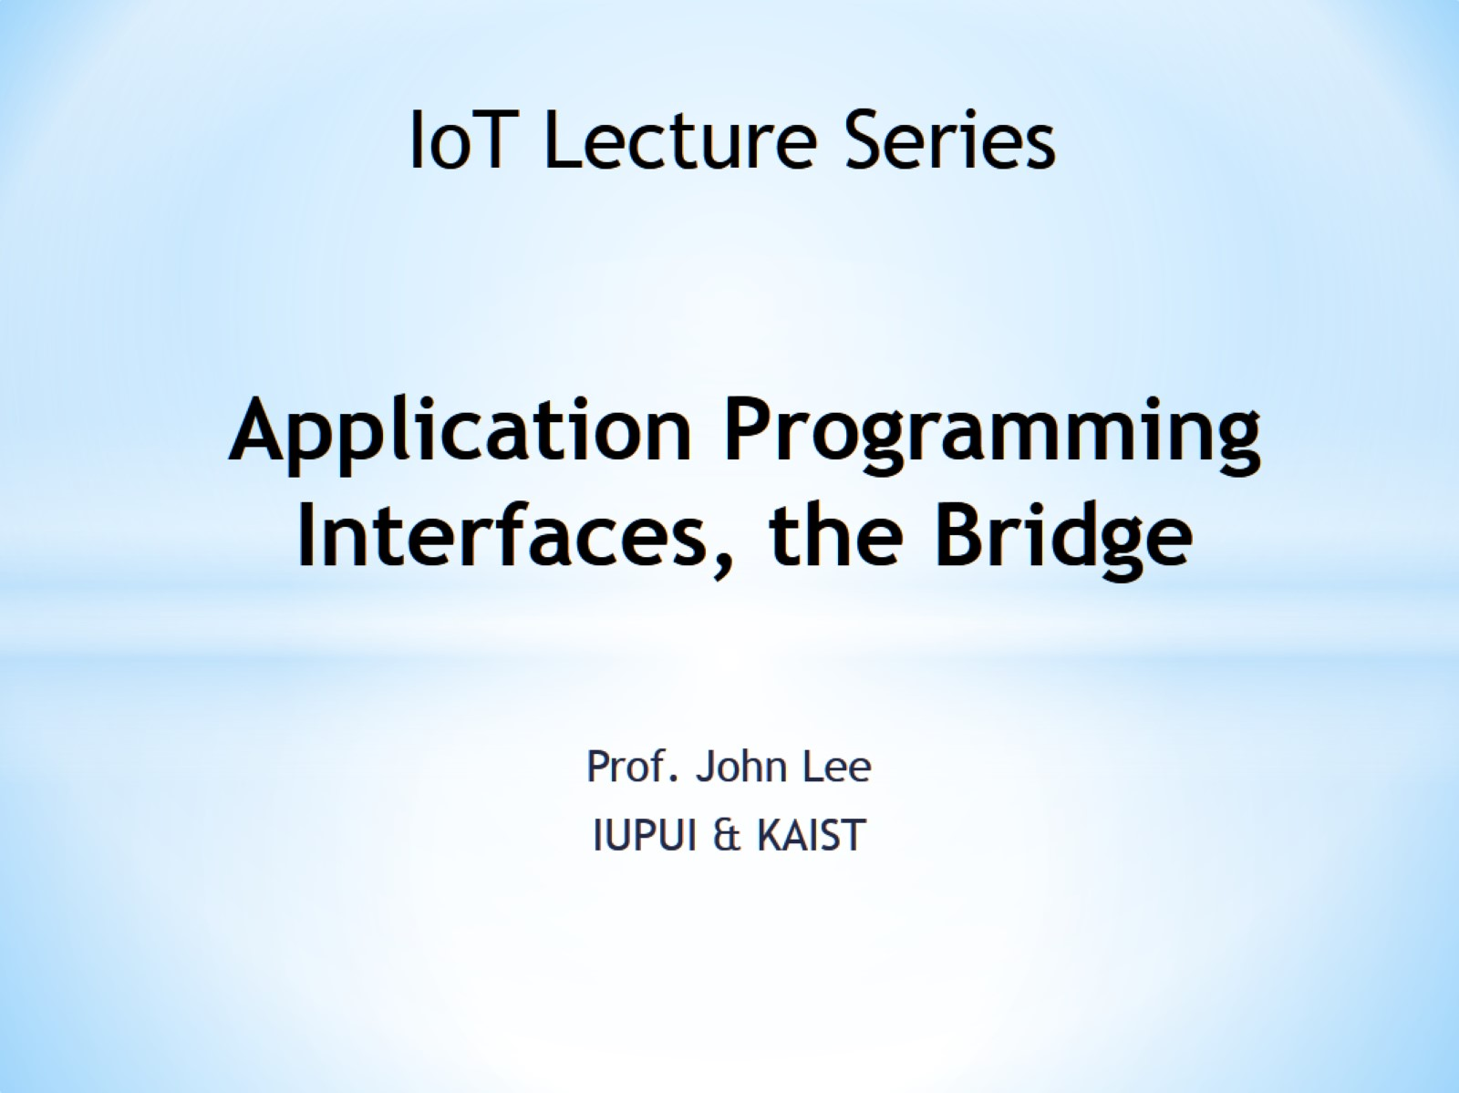
Application Programming Interfaces, the Bridge

Slide 2
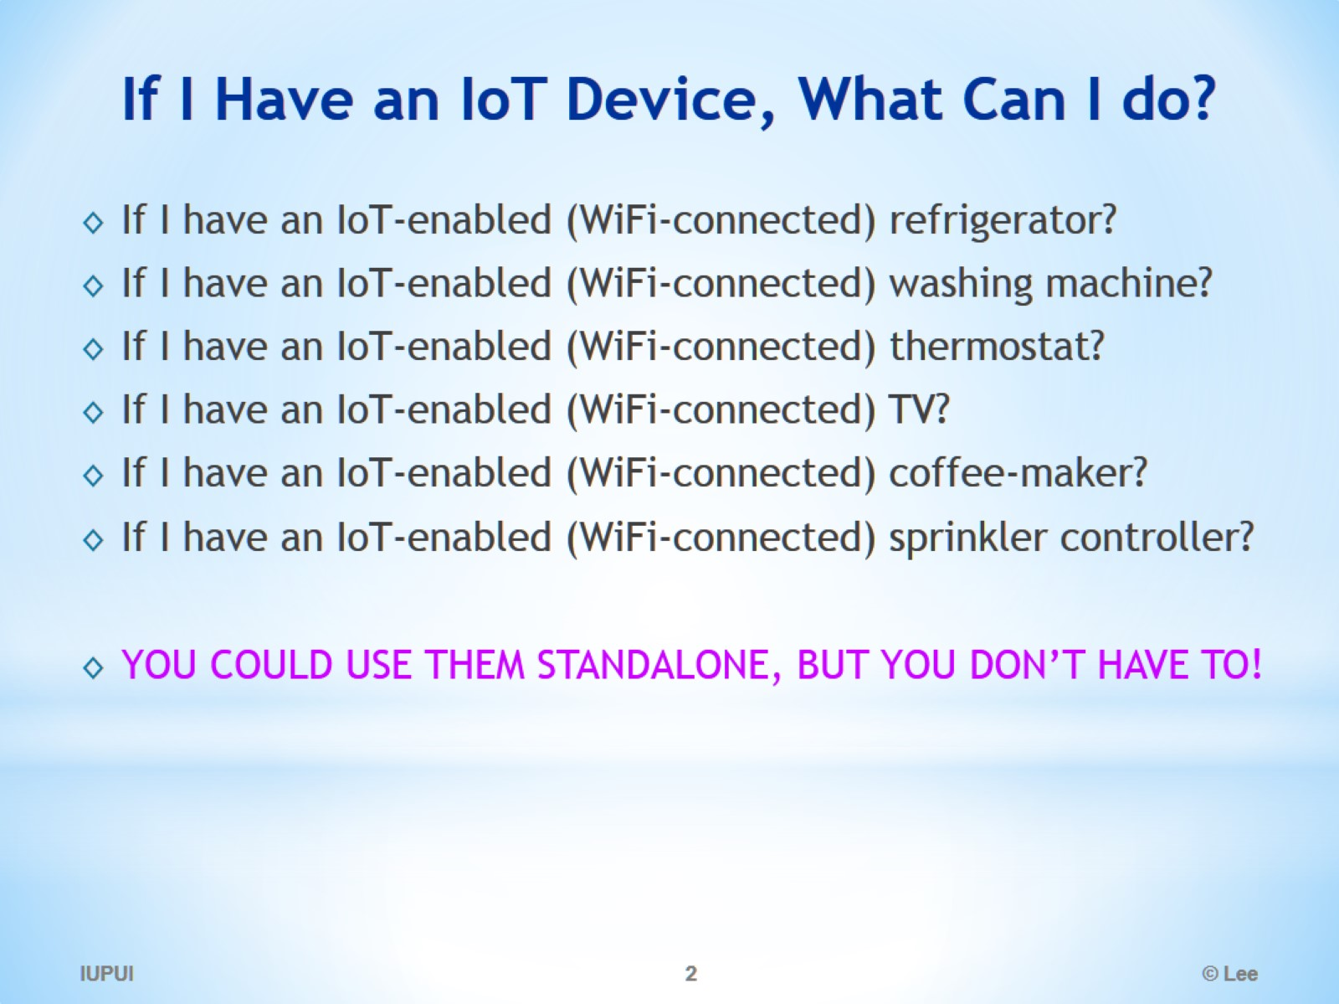
If I Have an IoT Device, What Can I do?

Slide 3
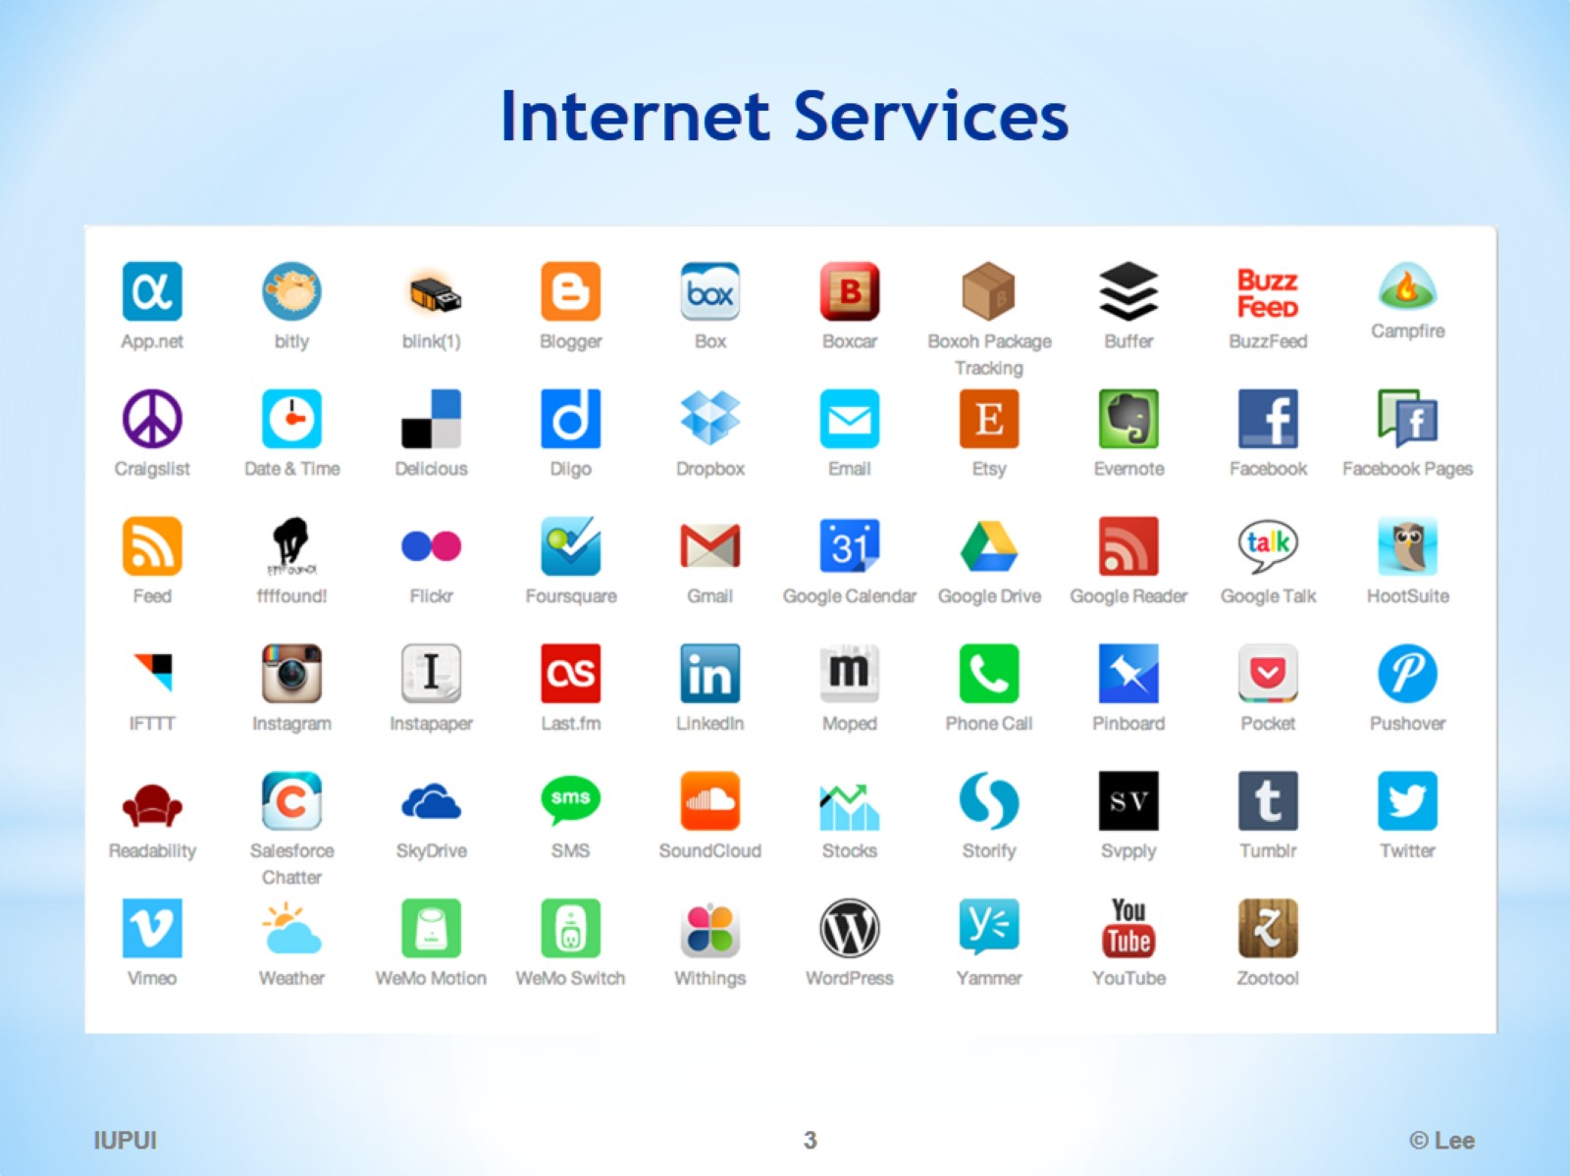
Internet Services

Slide 4
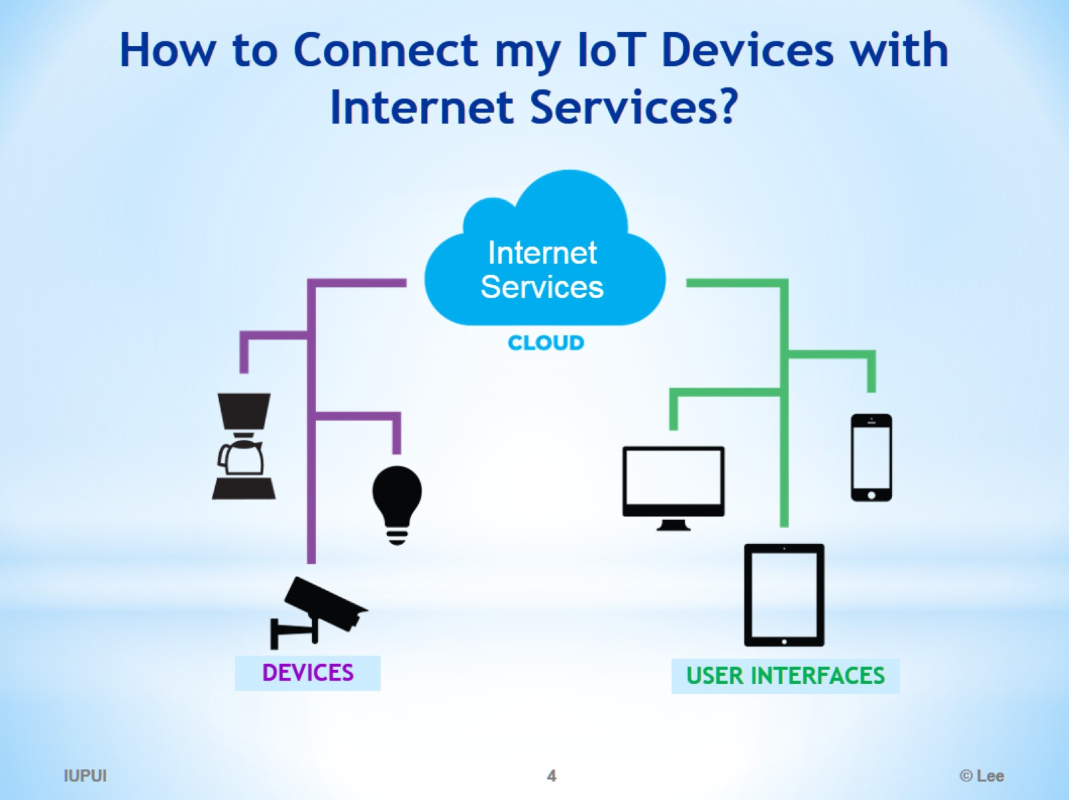
How to Connect my IoT Devices with Internet Services?

Slide 5
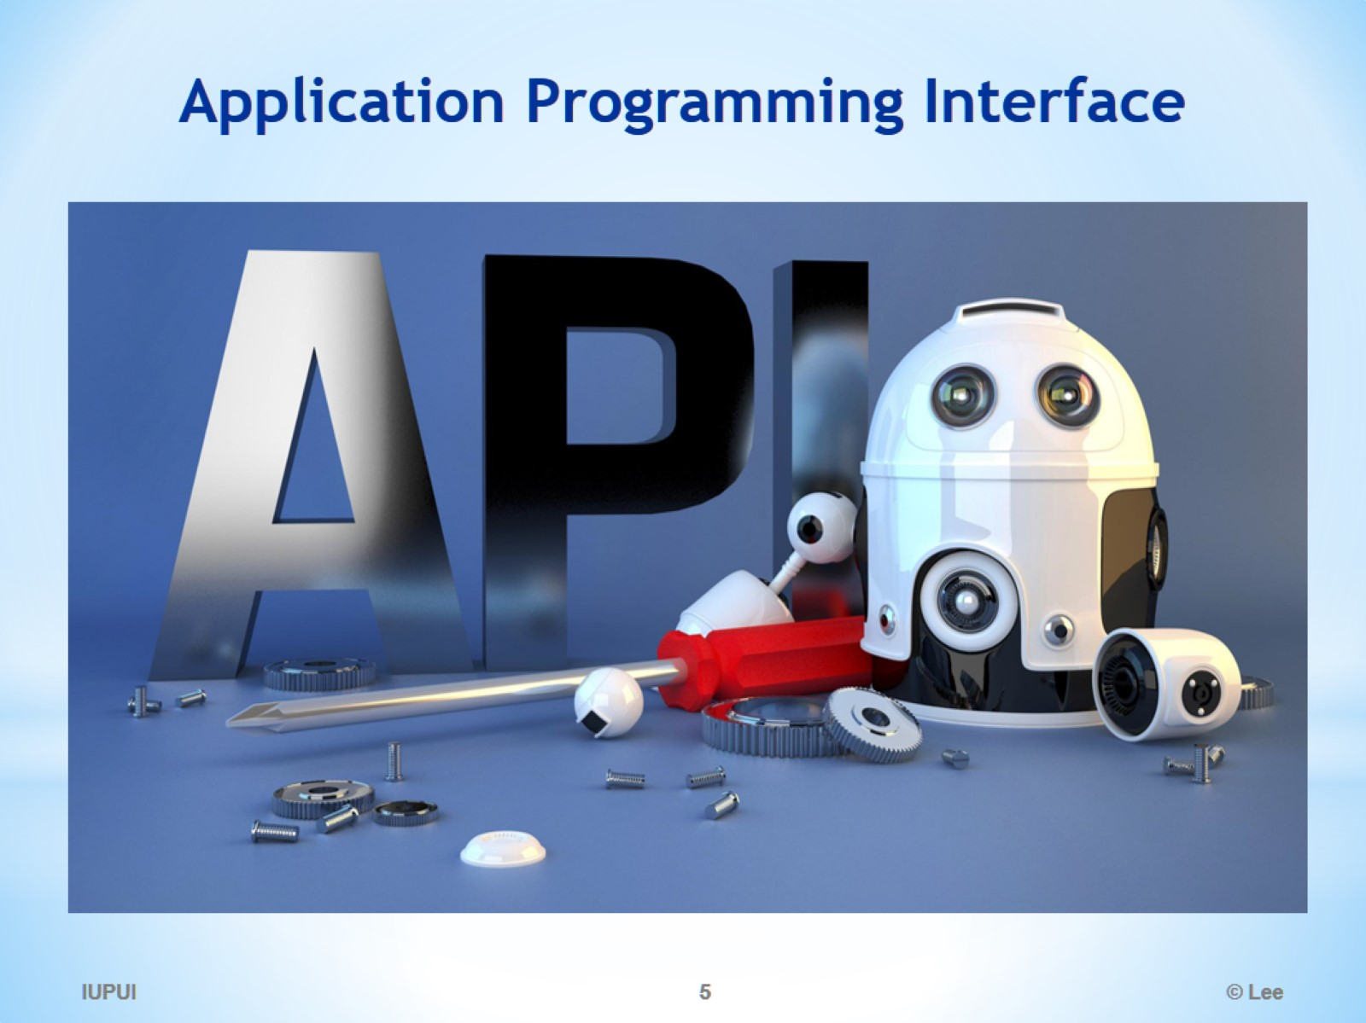
Application Programming Interface

Slide 6
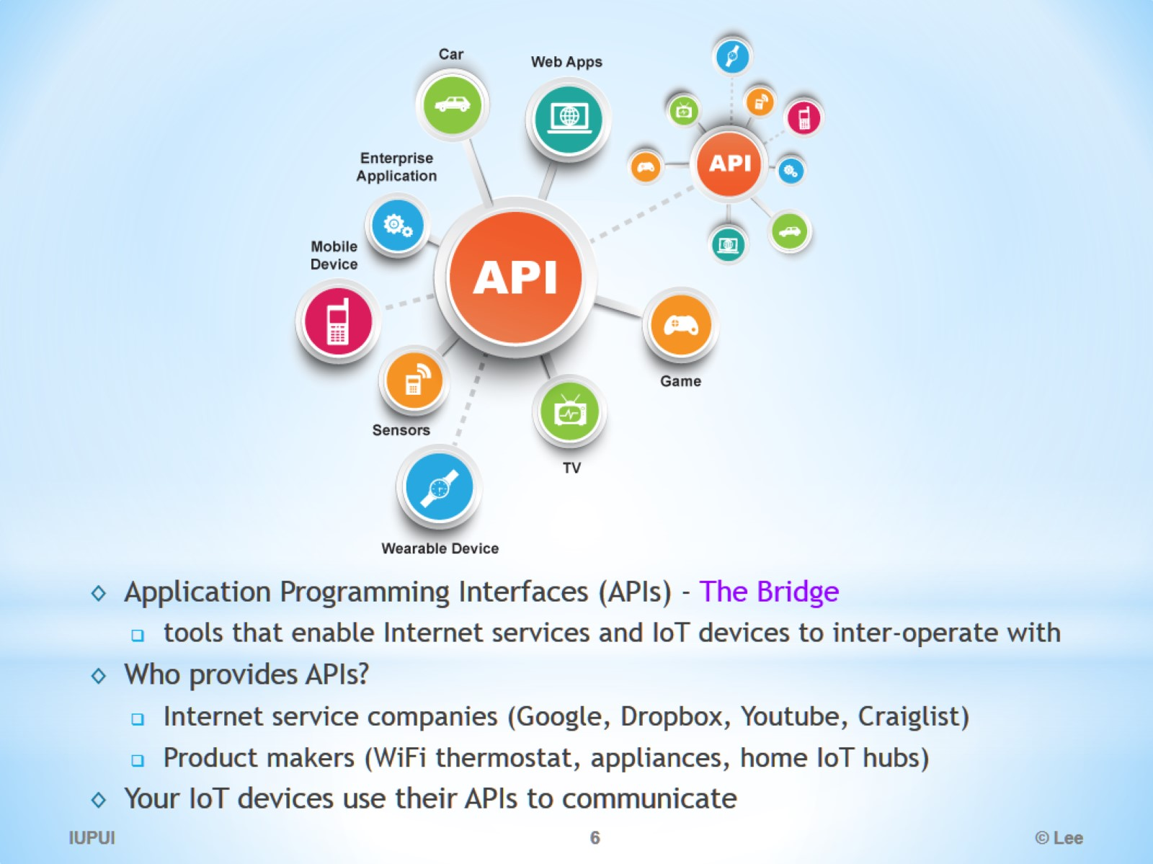

Slide 7
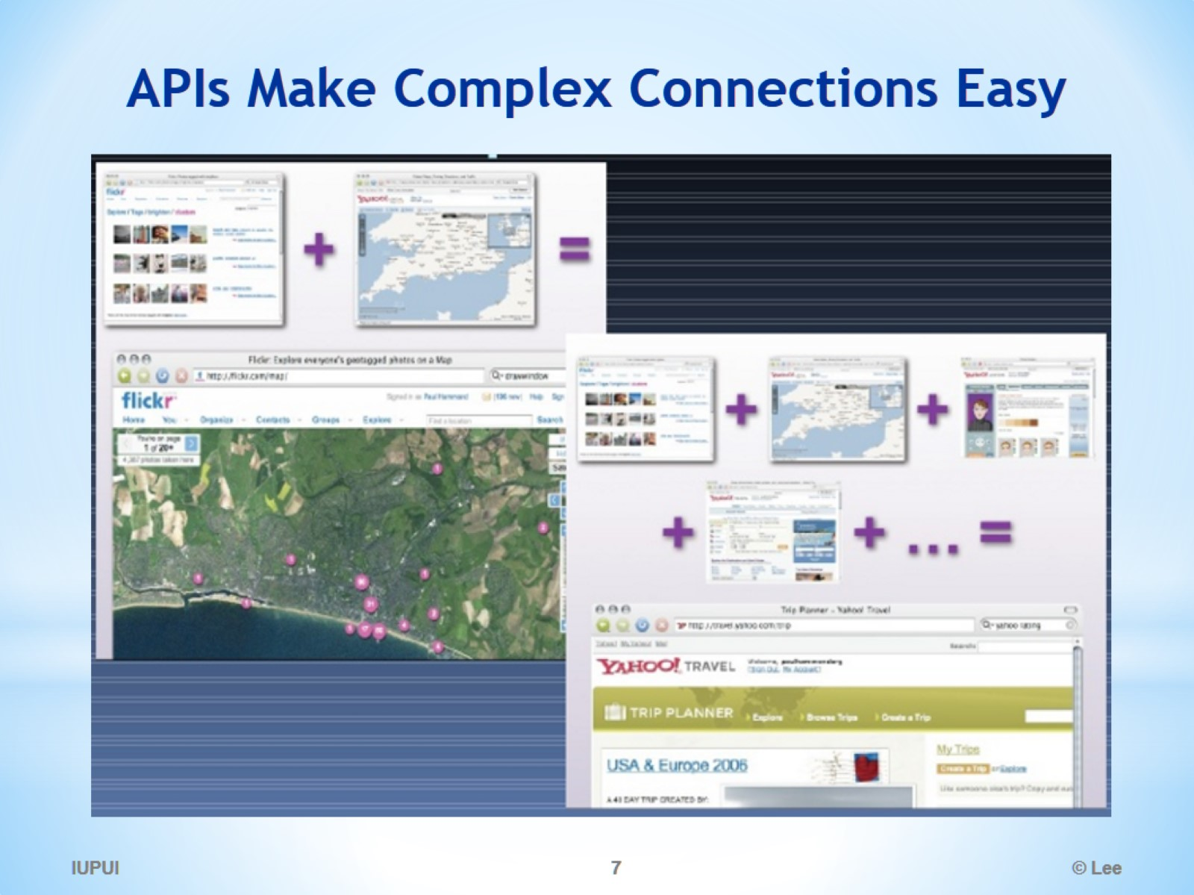
APIs Make Complex Connections Easy

Slide 8
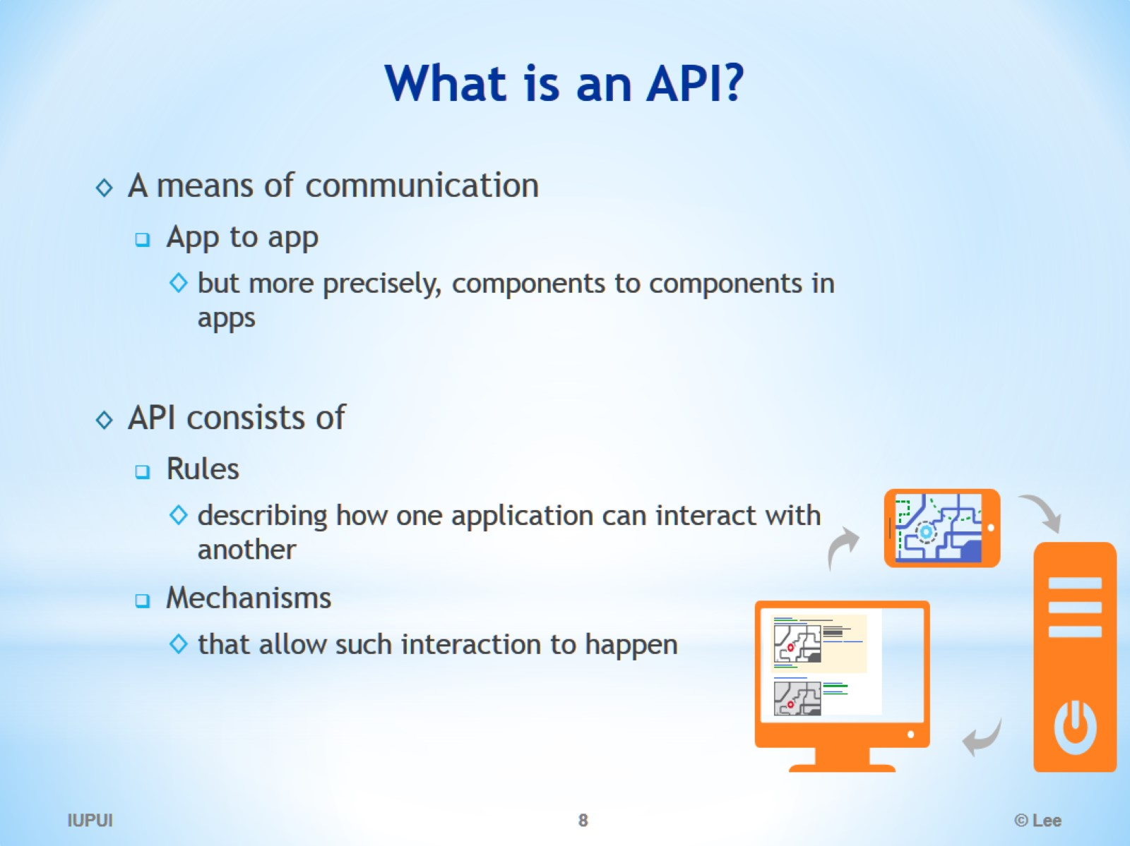
What is an API?

Slide 9
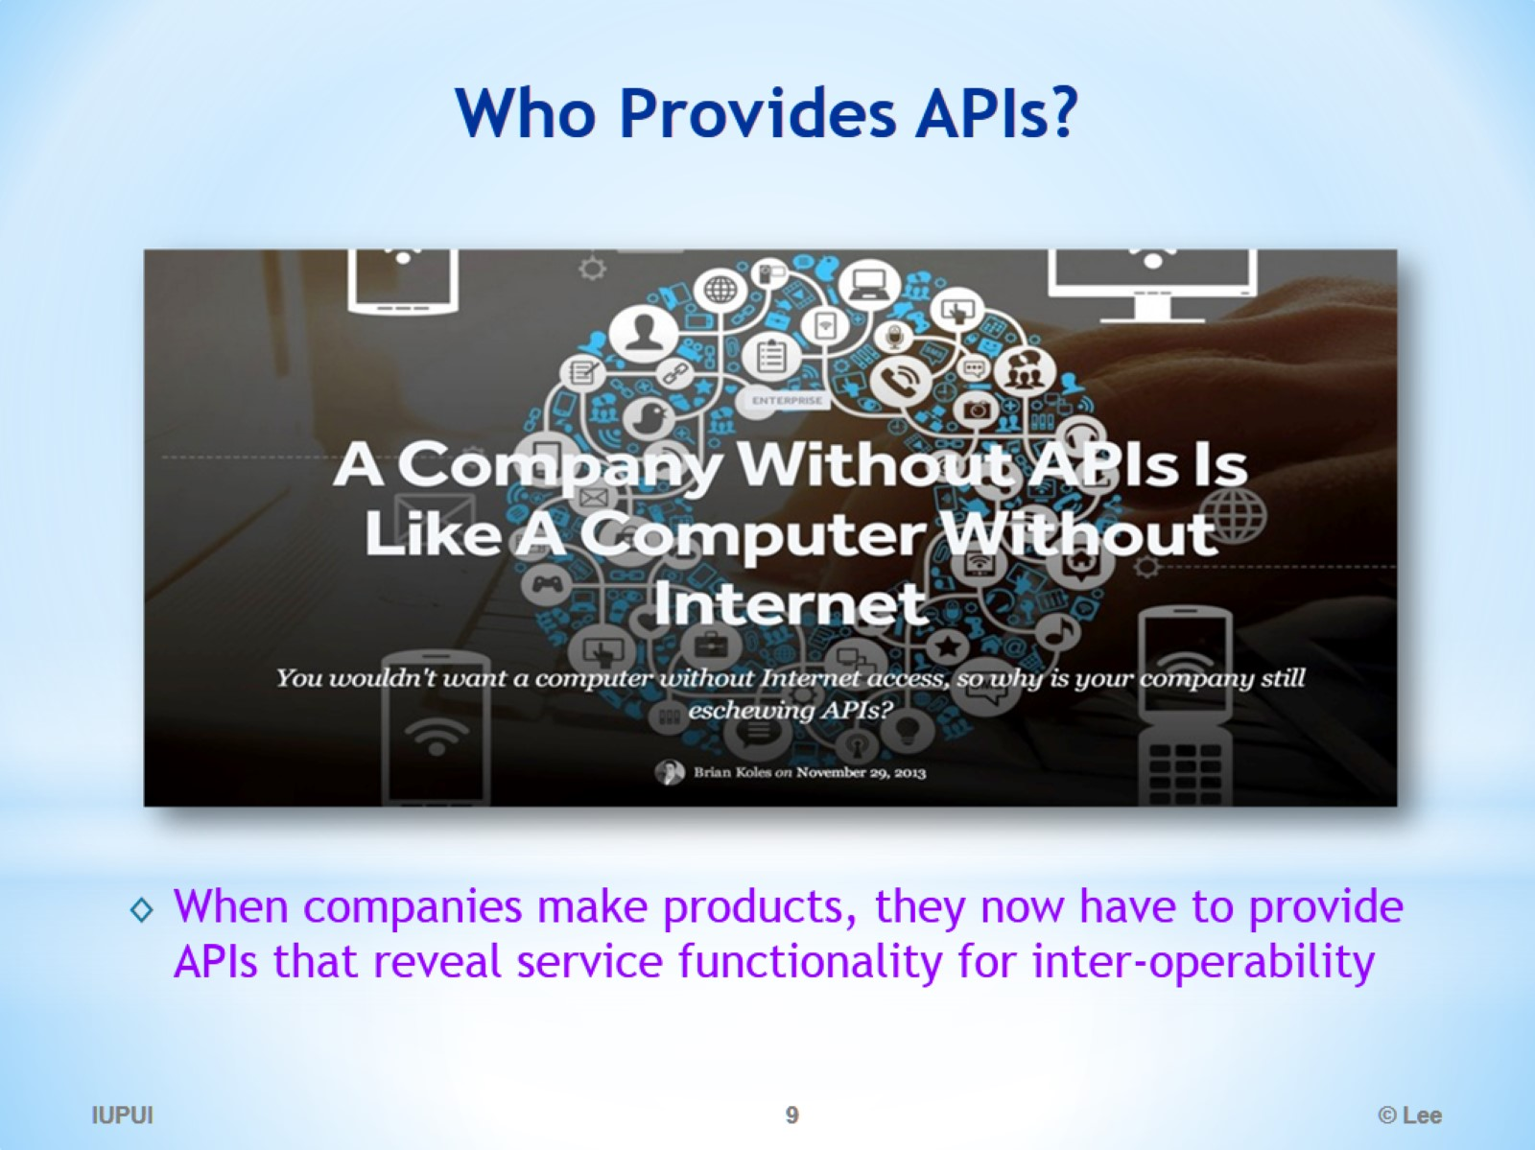
Who Provides APIs?

Slide 10
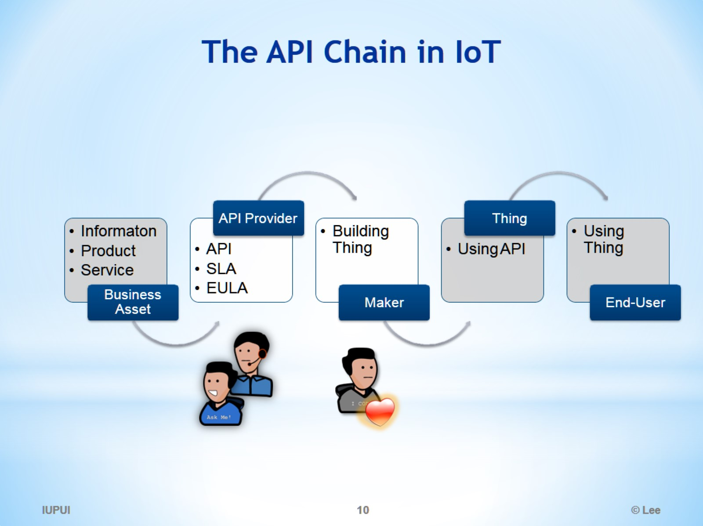
The API Chain in IoT

Slide 11
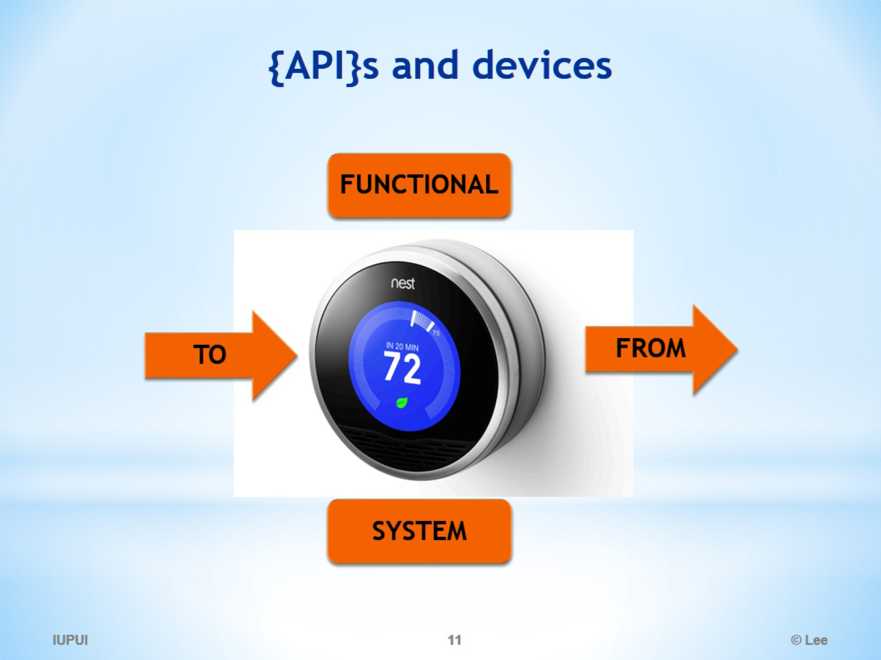
{API}s and devices

Slide 12
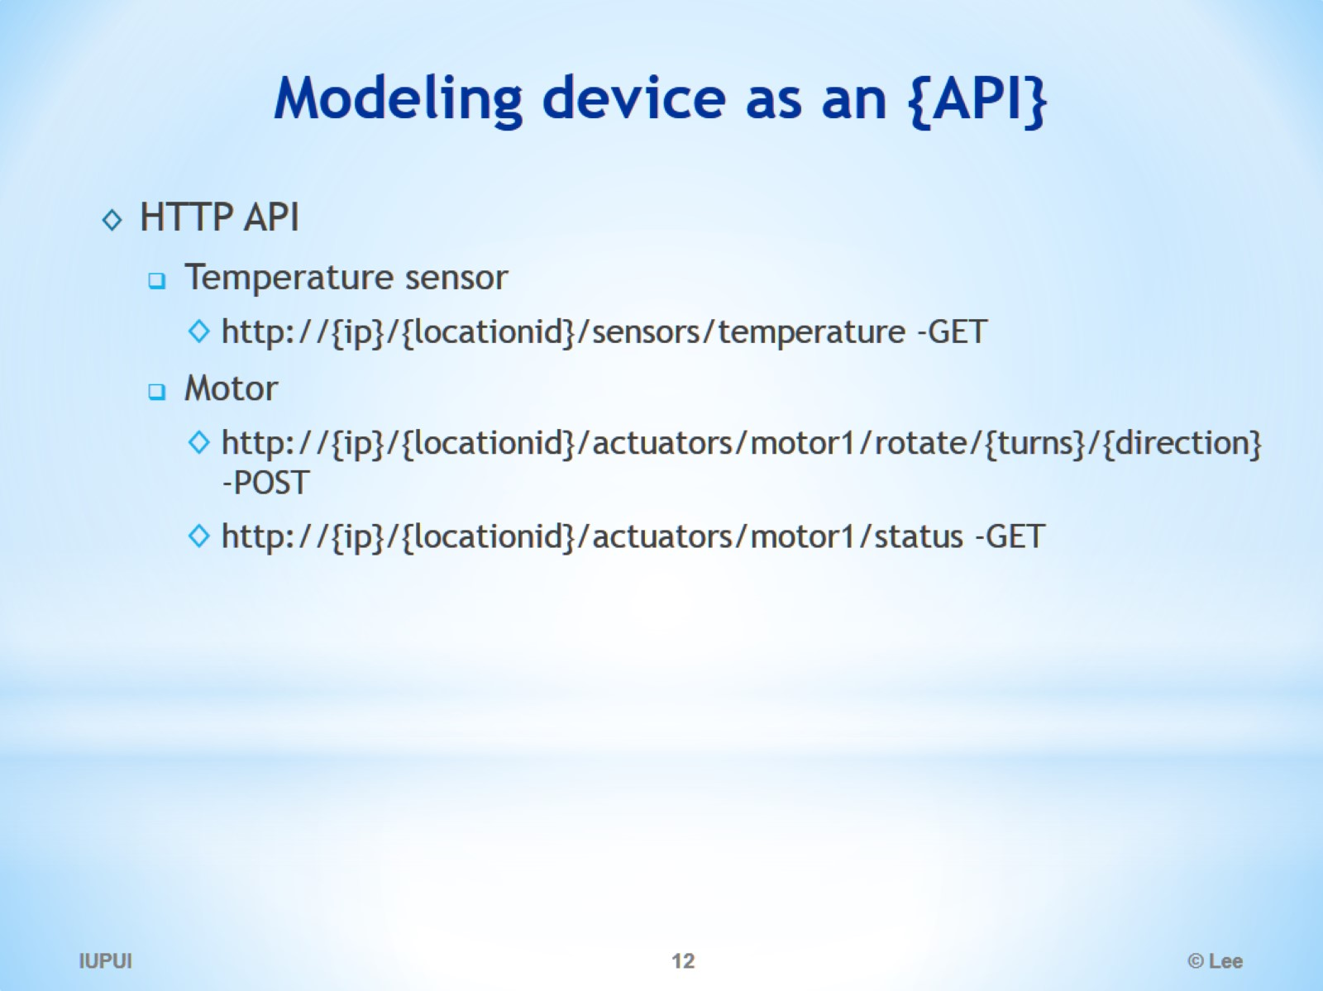
Modeling device as an {API}

Slide 13
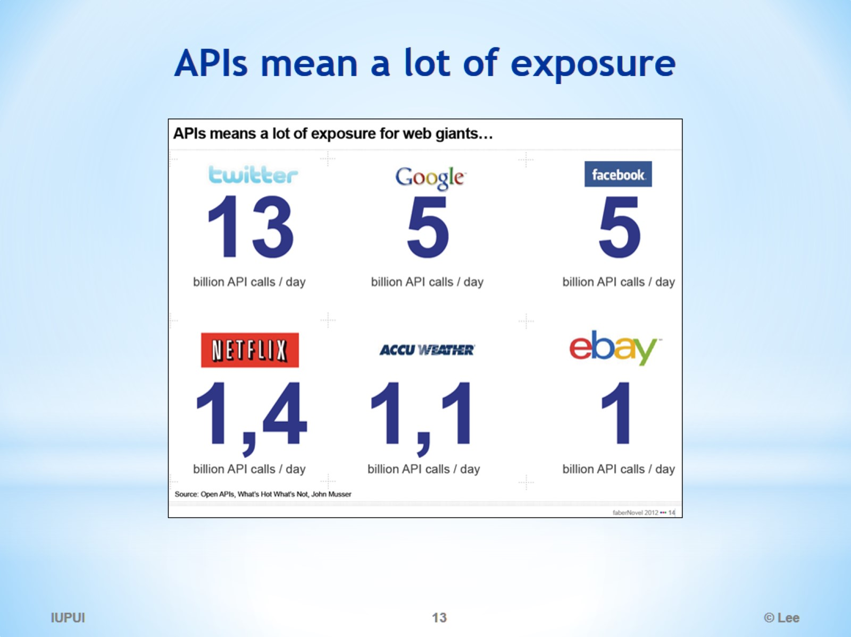
APIs mean a lot of exposure

Slide 14
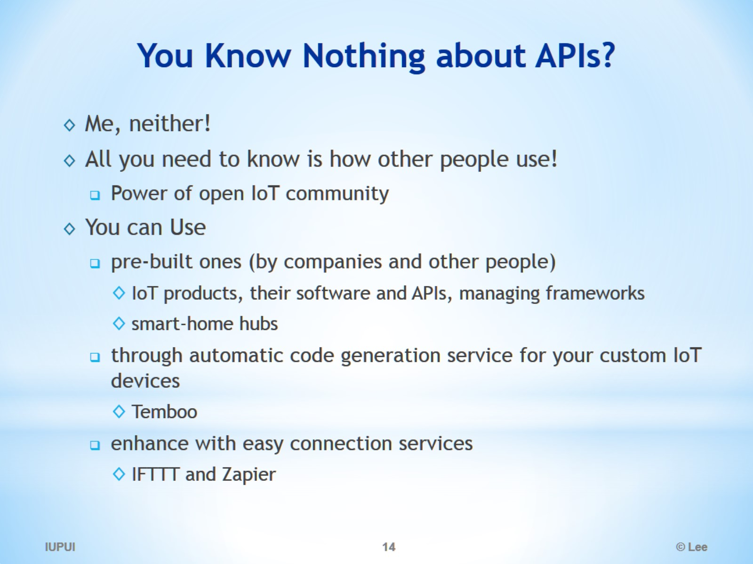
You Know Nothing about APIs?

Slide 15
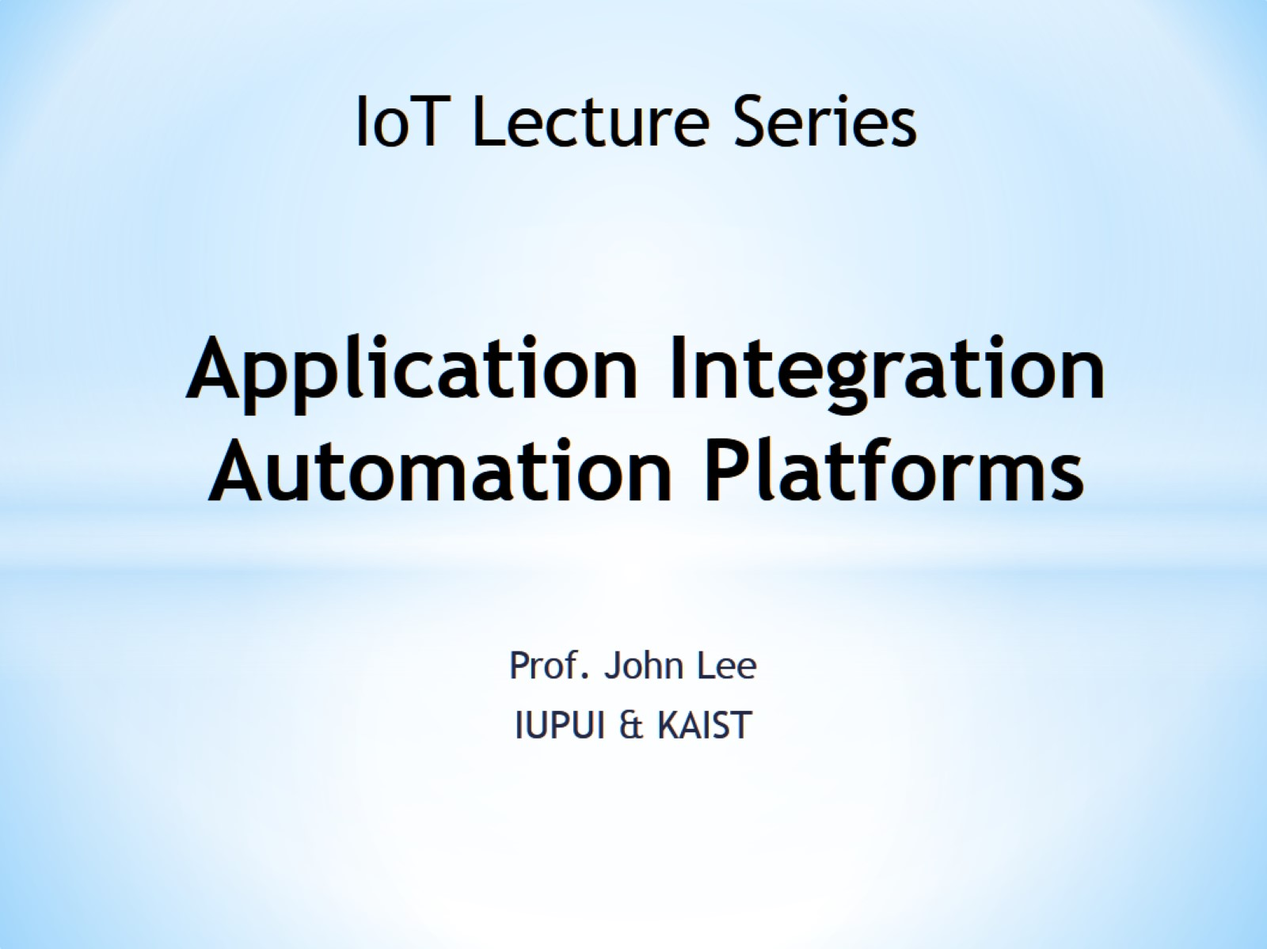
Application Integration Automation Platforms

Slide 16
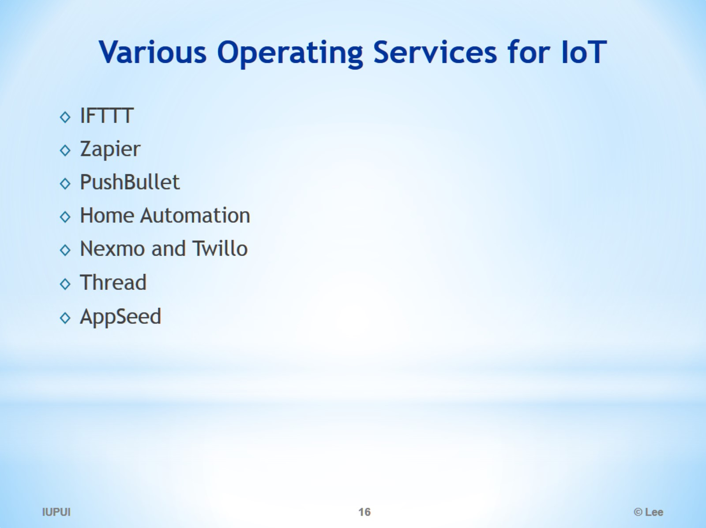
Various Operating Services for IoT

Slide 17
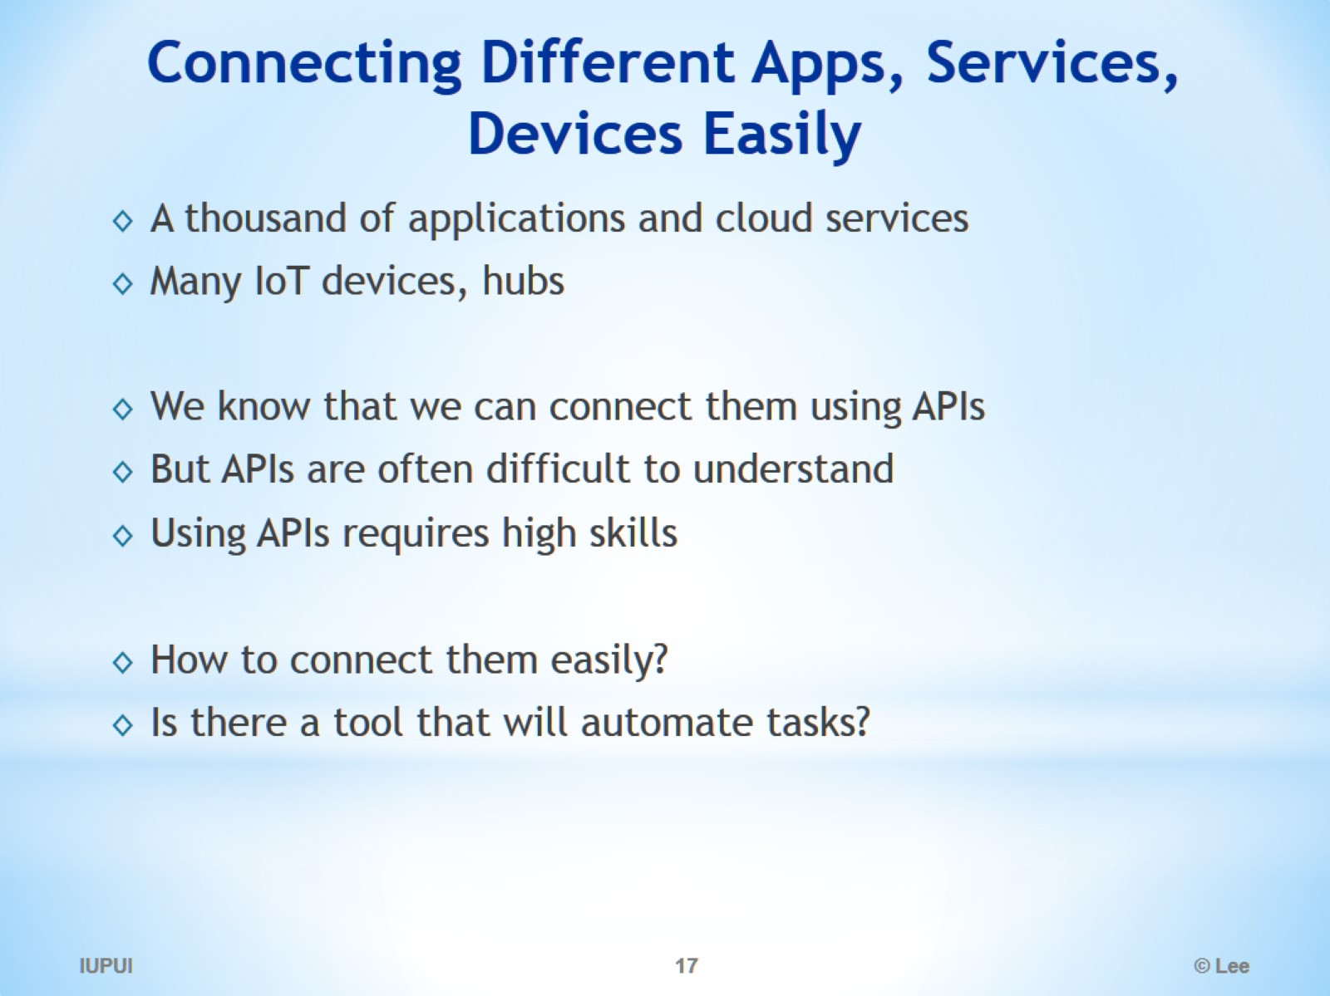
Connecting Different Apps, Services, Devices Easily

Slide 18
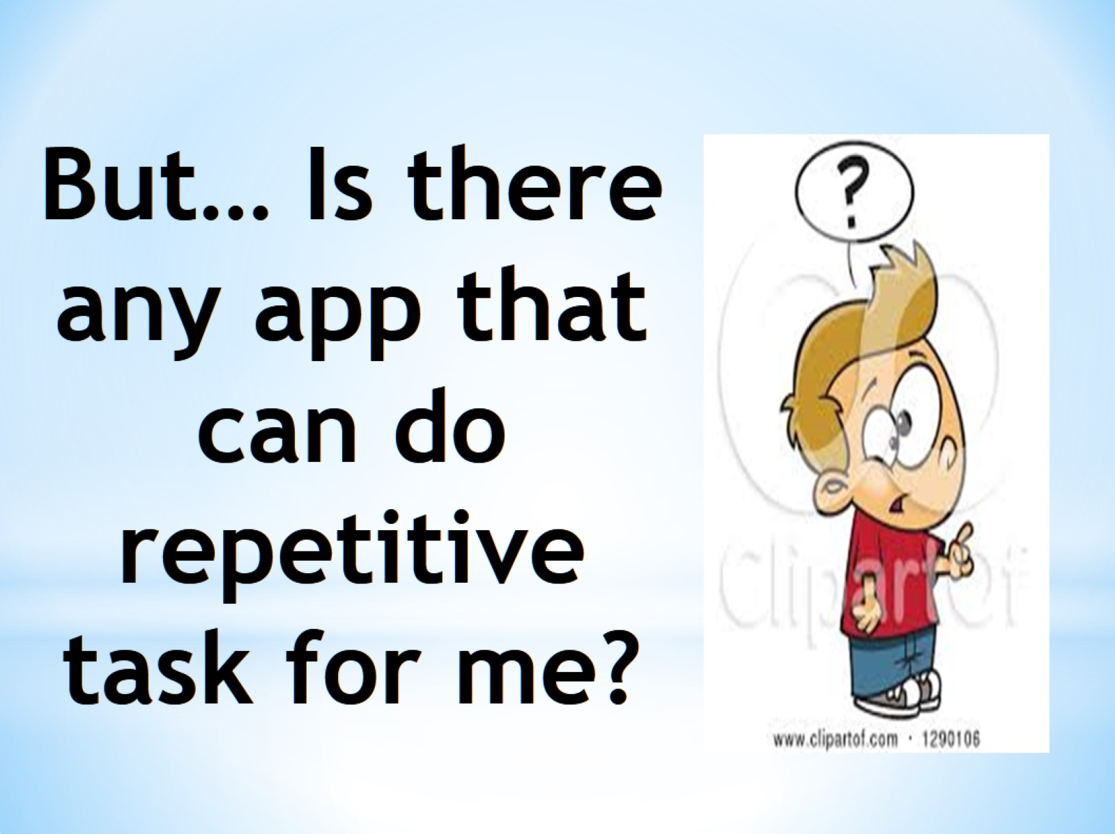
But… Is there any app that can do repetitive task for me?

Slide 19


Slide 20


Slide 21
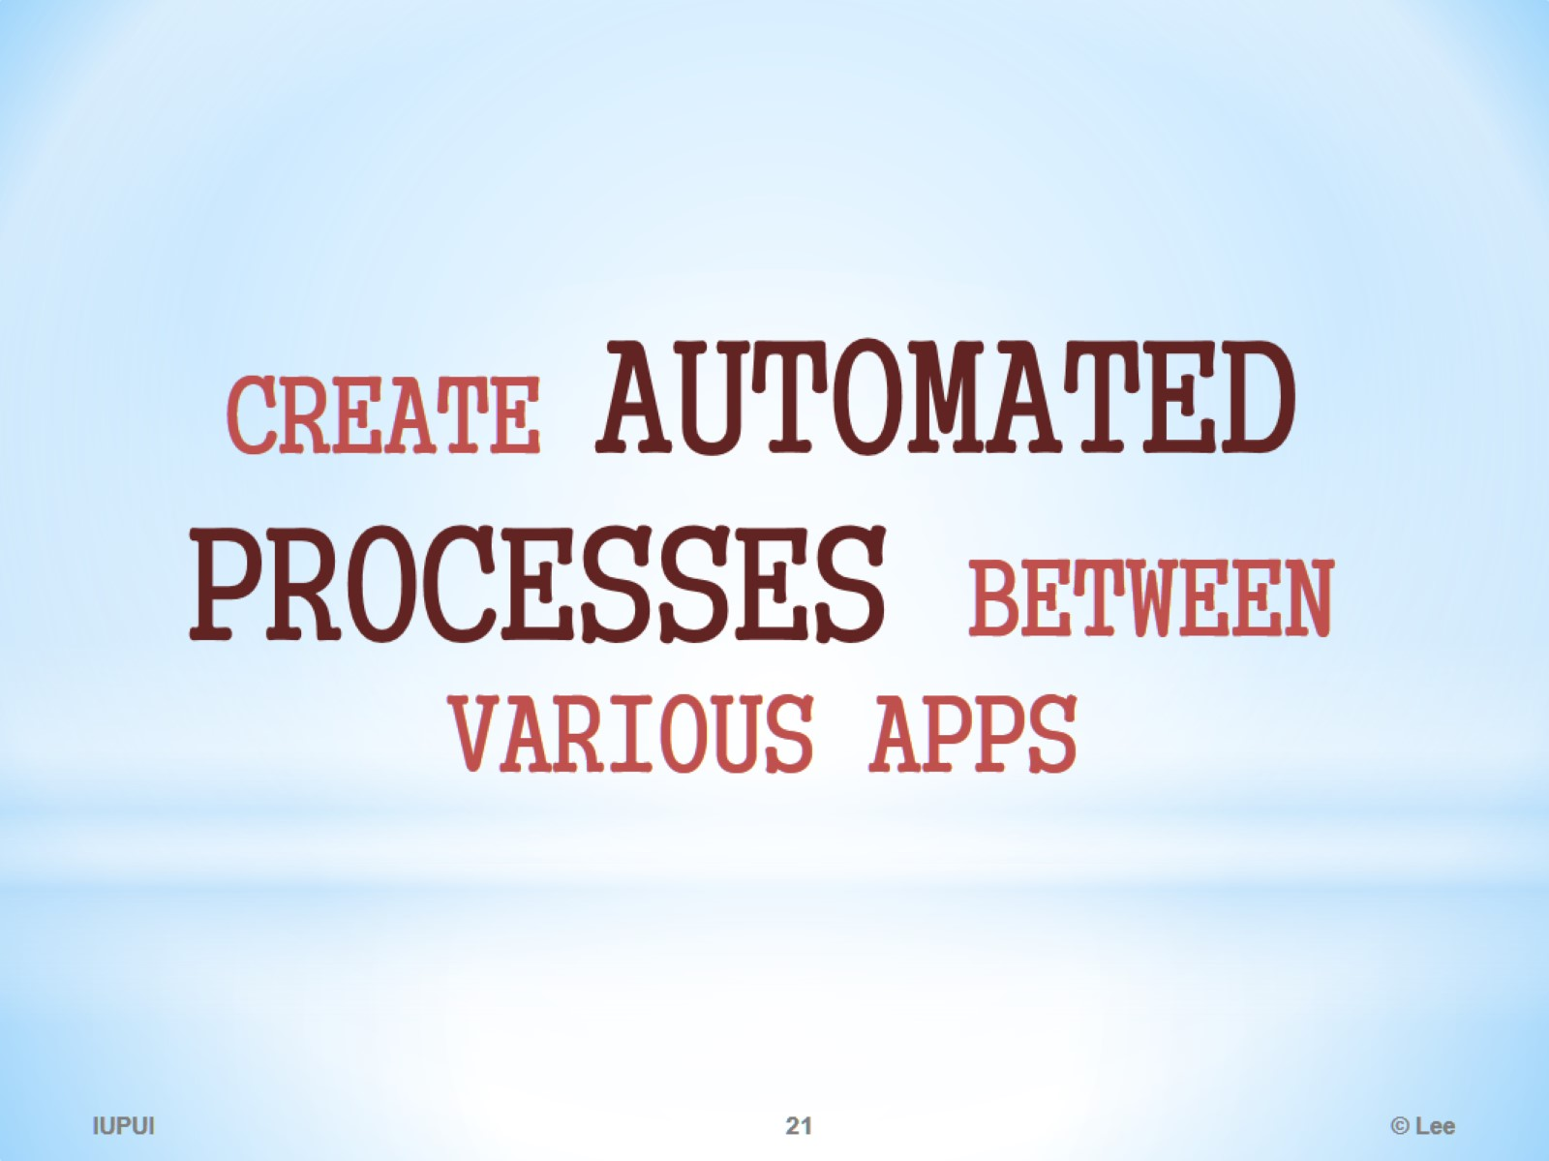

Slide 22
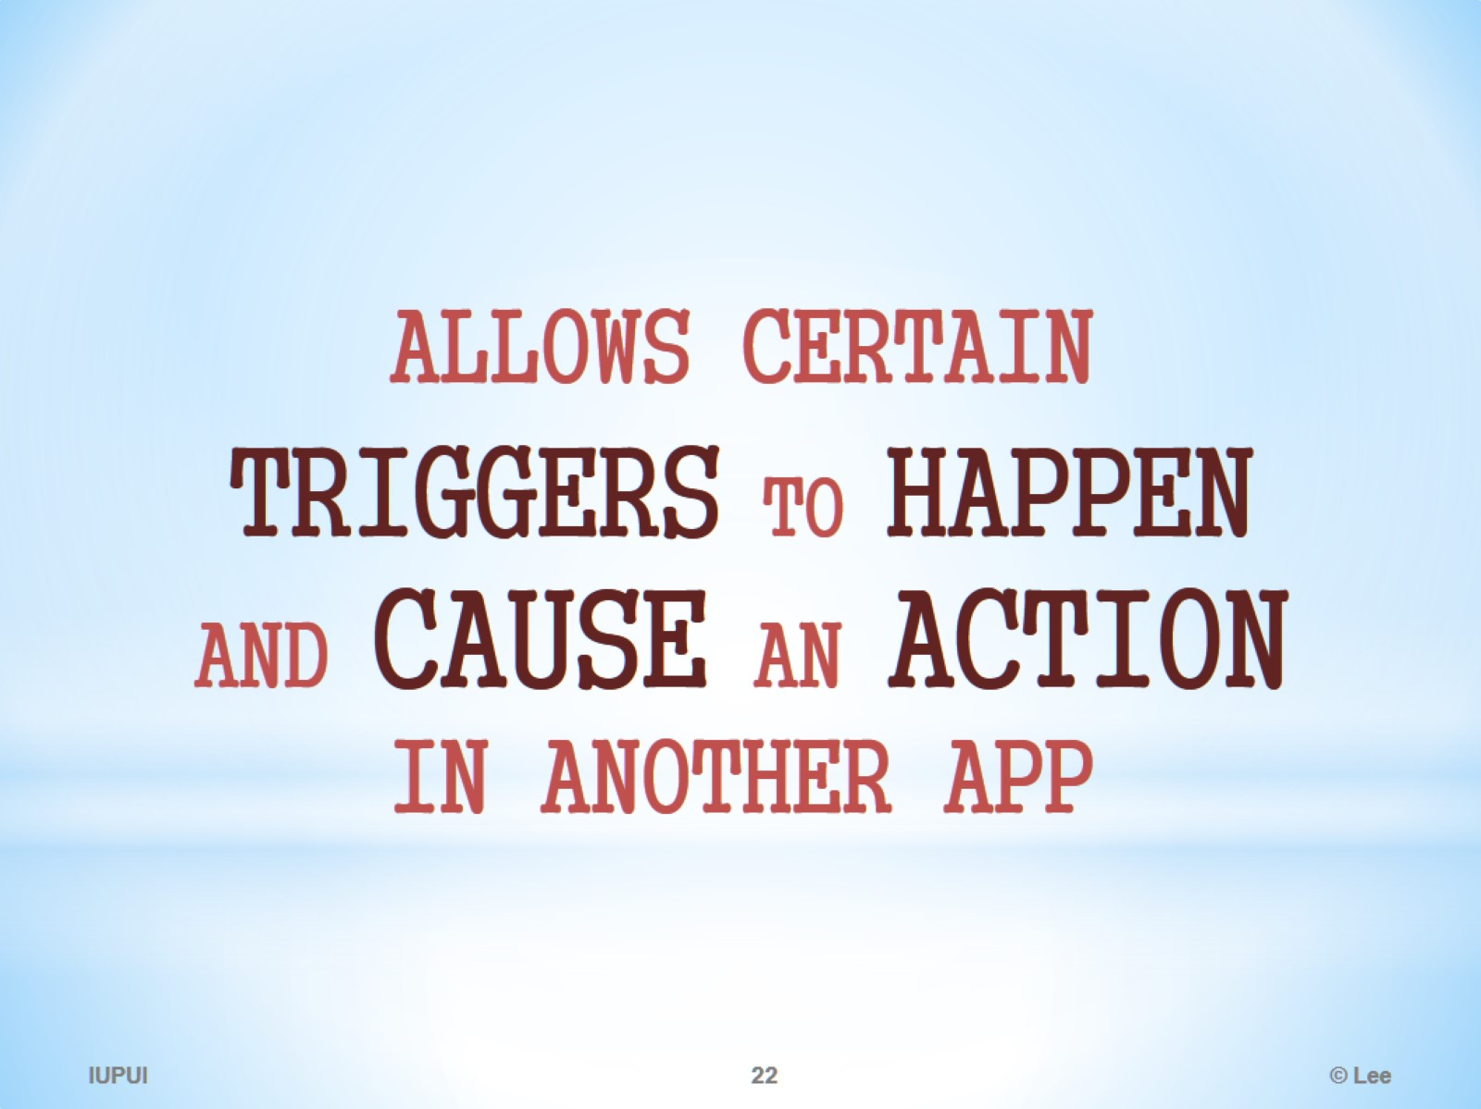

Slide 23
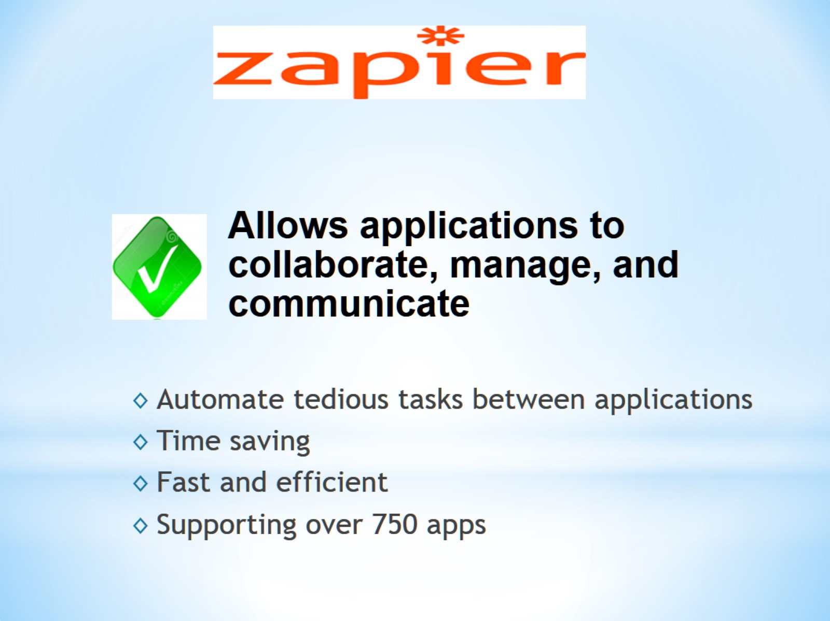

Slide 24
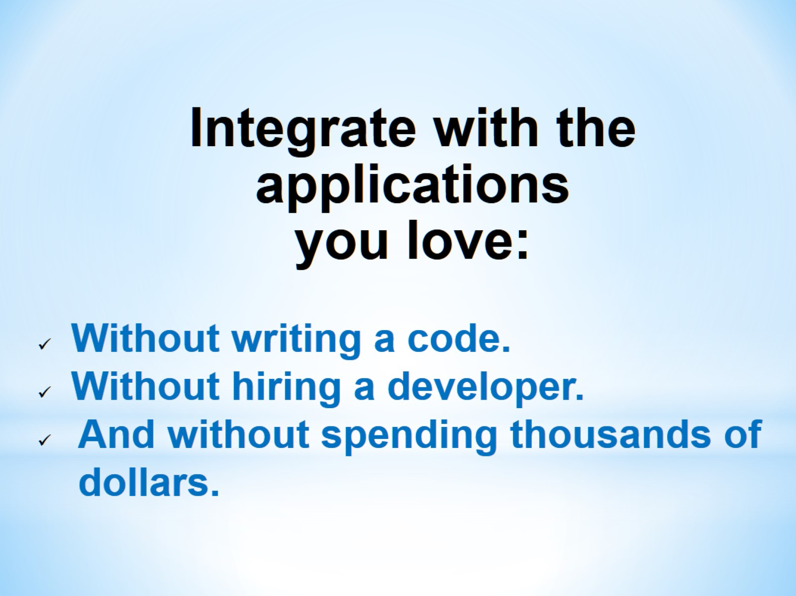

Slide 25
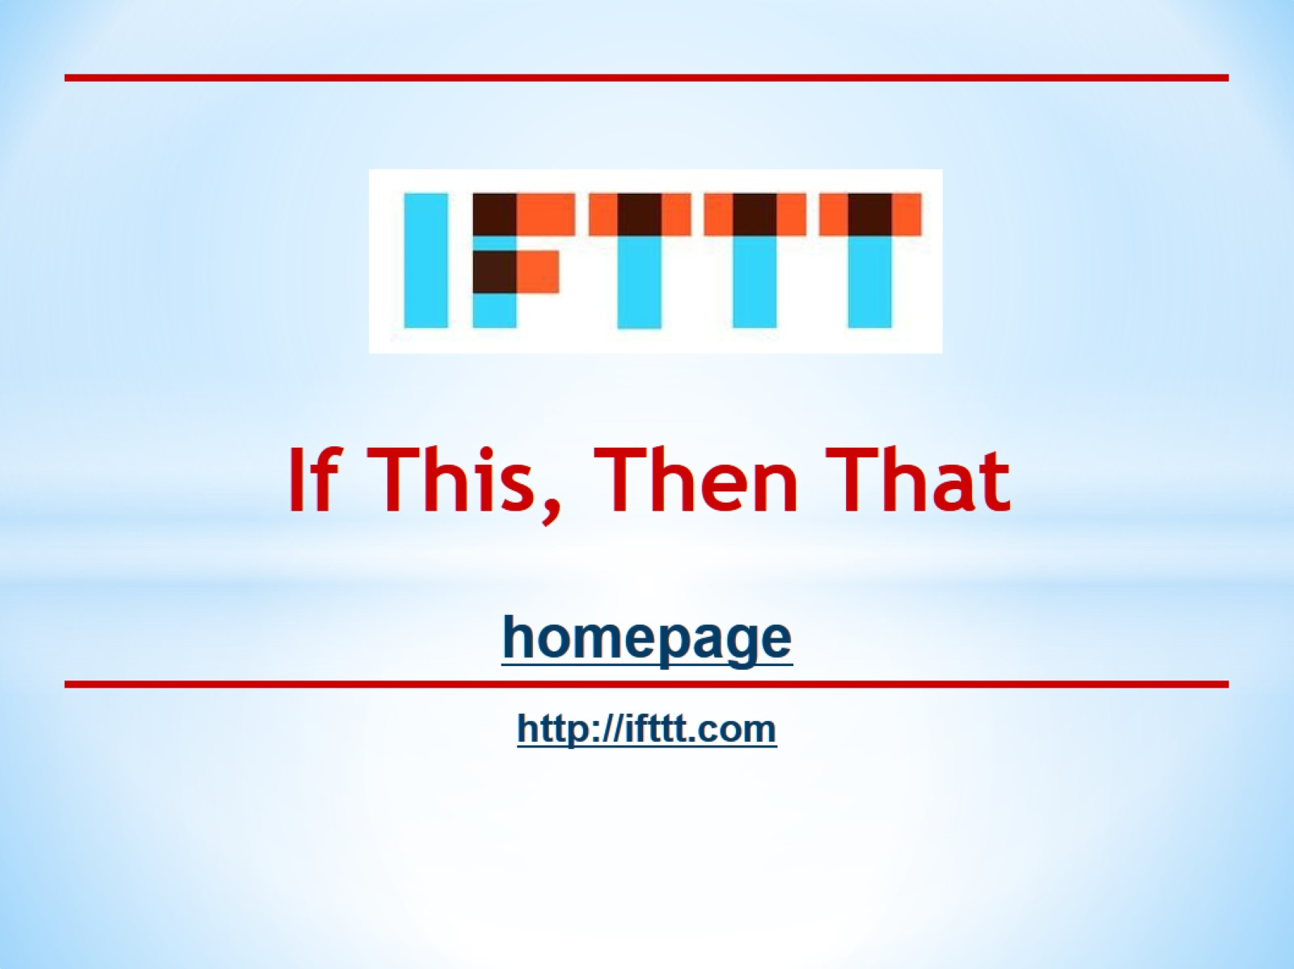
If This, Then That

Slide 26
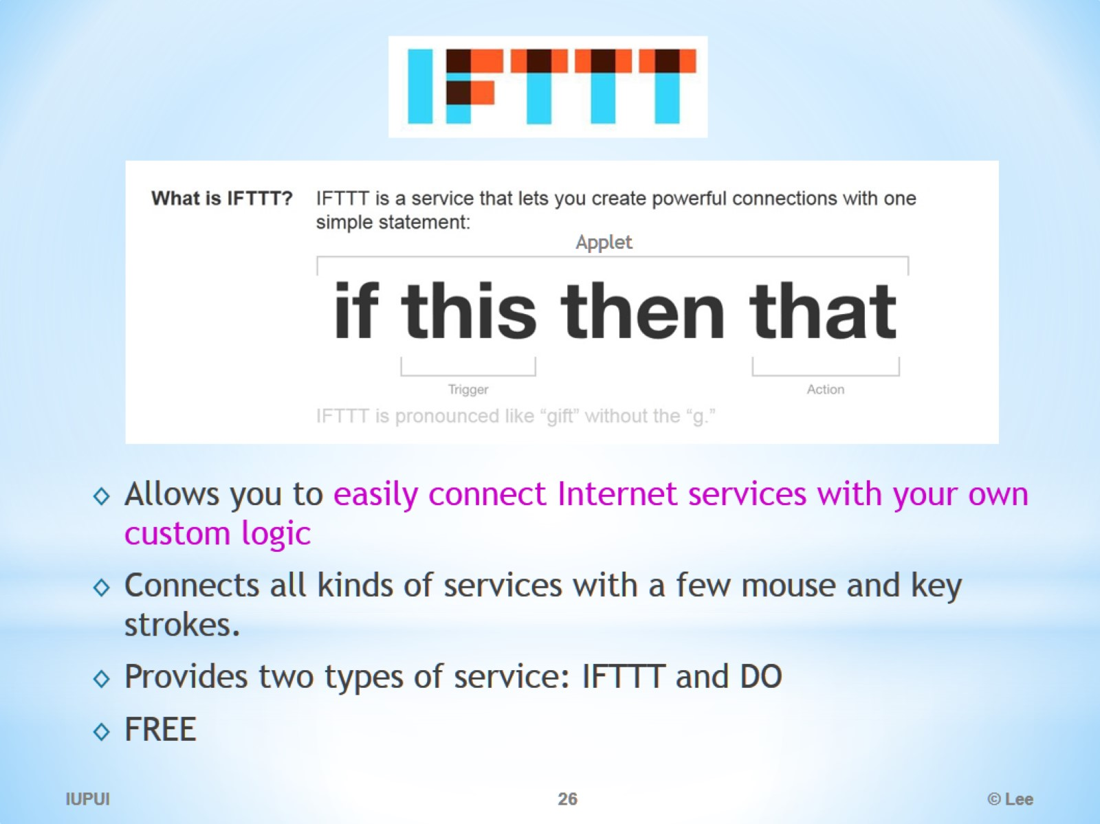
IFTTT

Slide 27
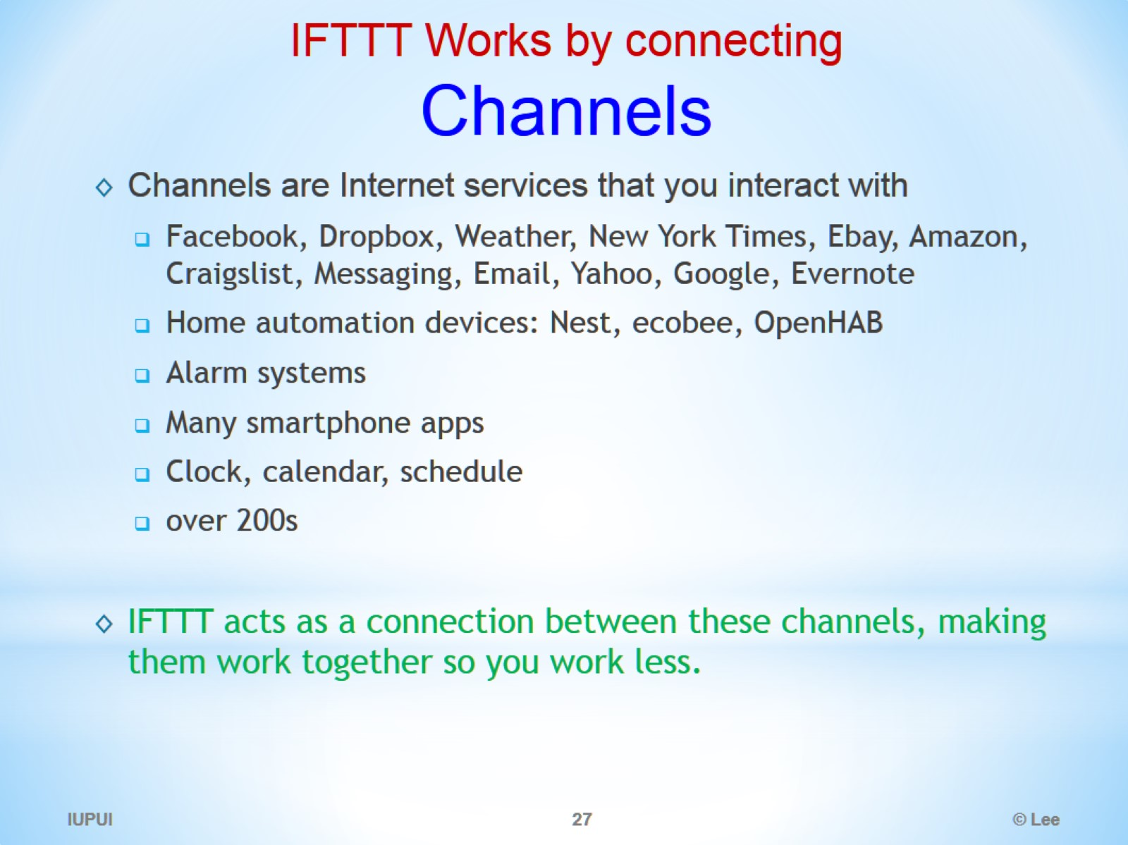
IFTTT Works by connecting Channels

Slide 28
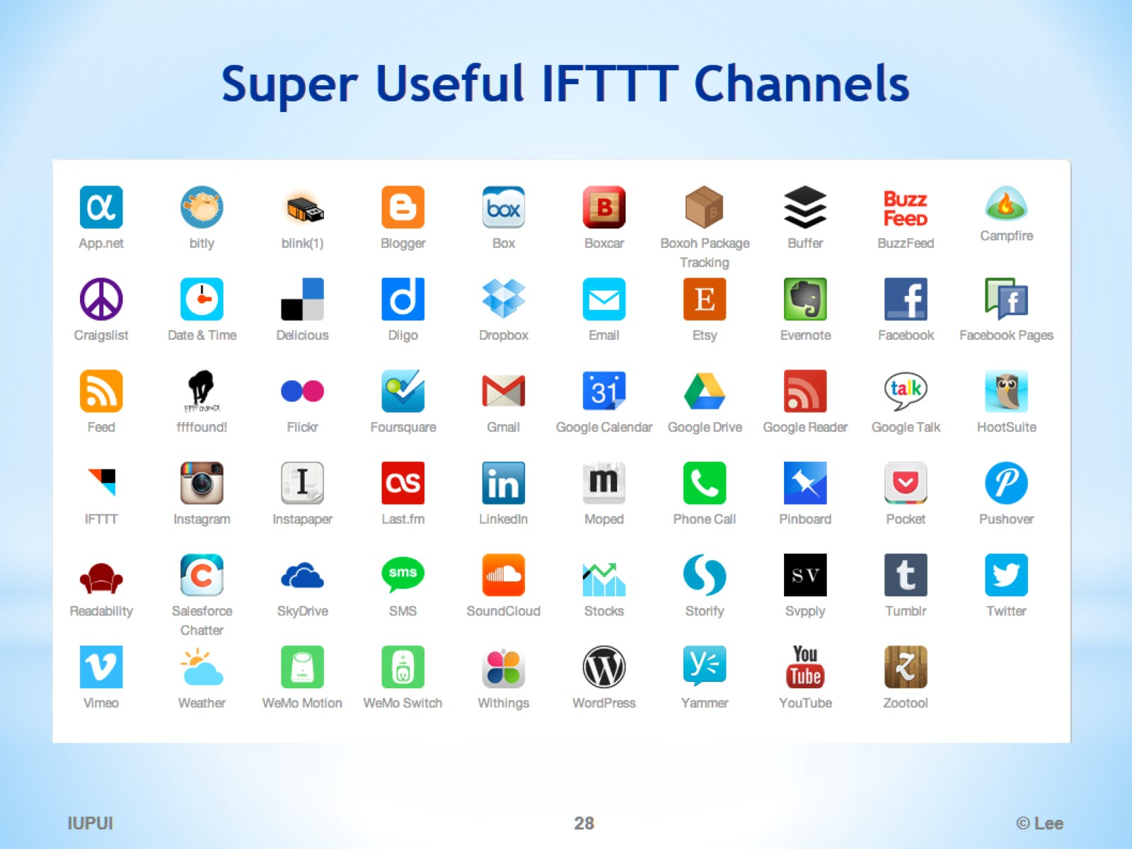
Super Useful IFTTT Channels

Slide 29
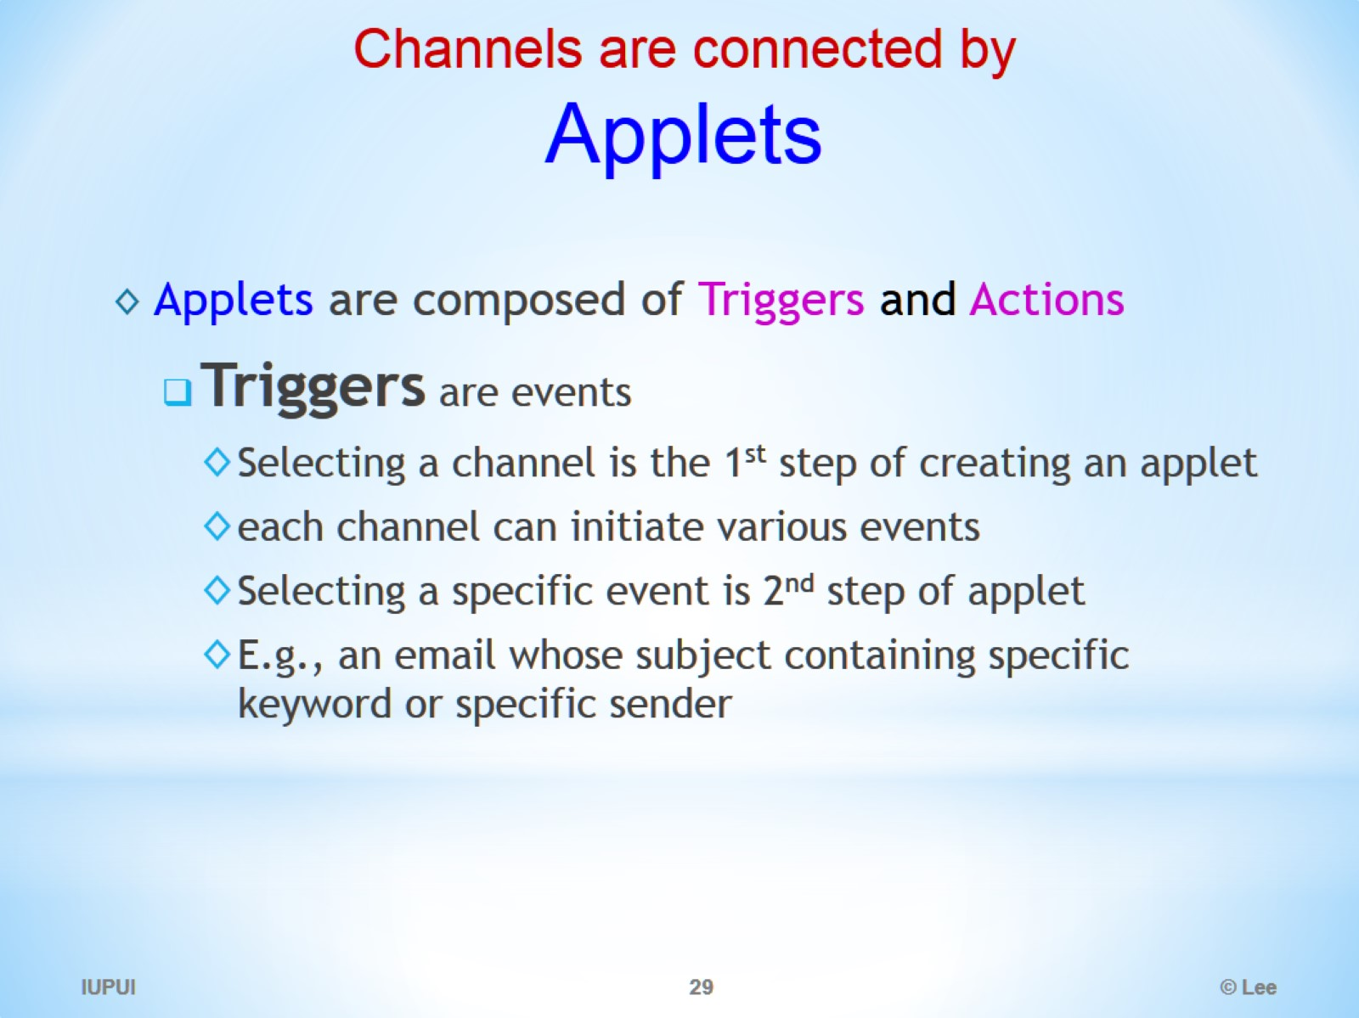
Channels are connected by Applets

Slide 30
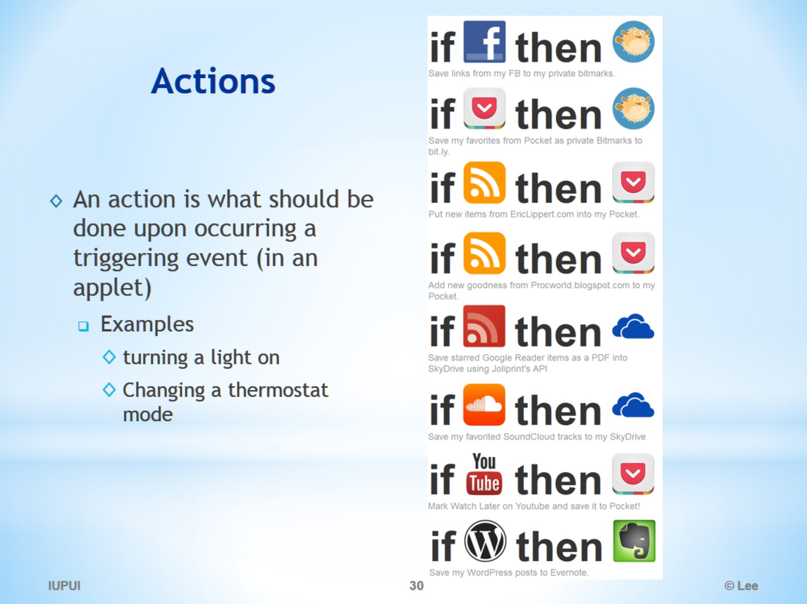
Actions

Slide 31
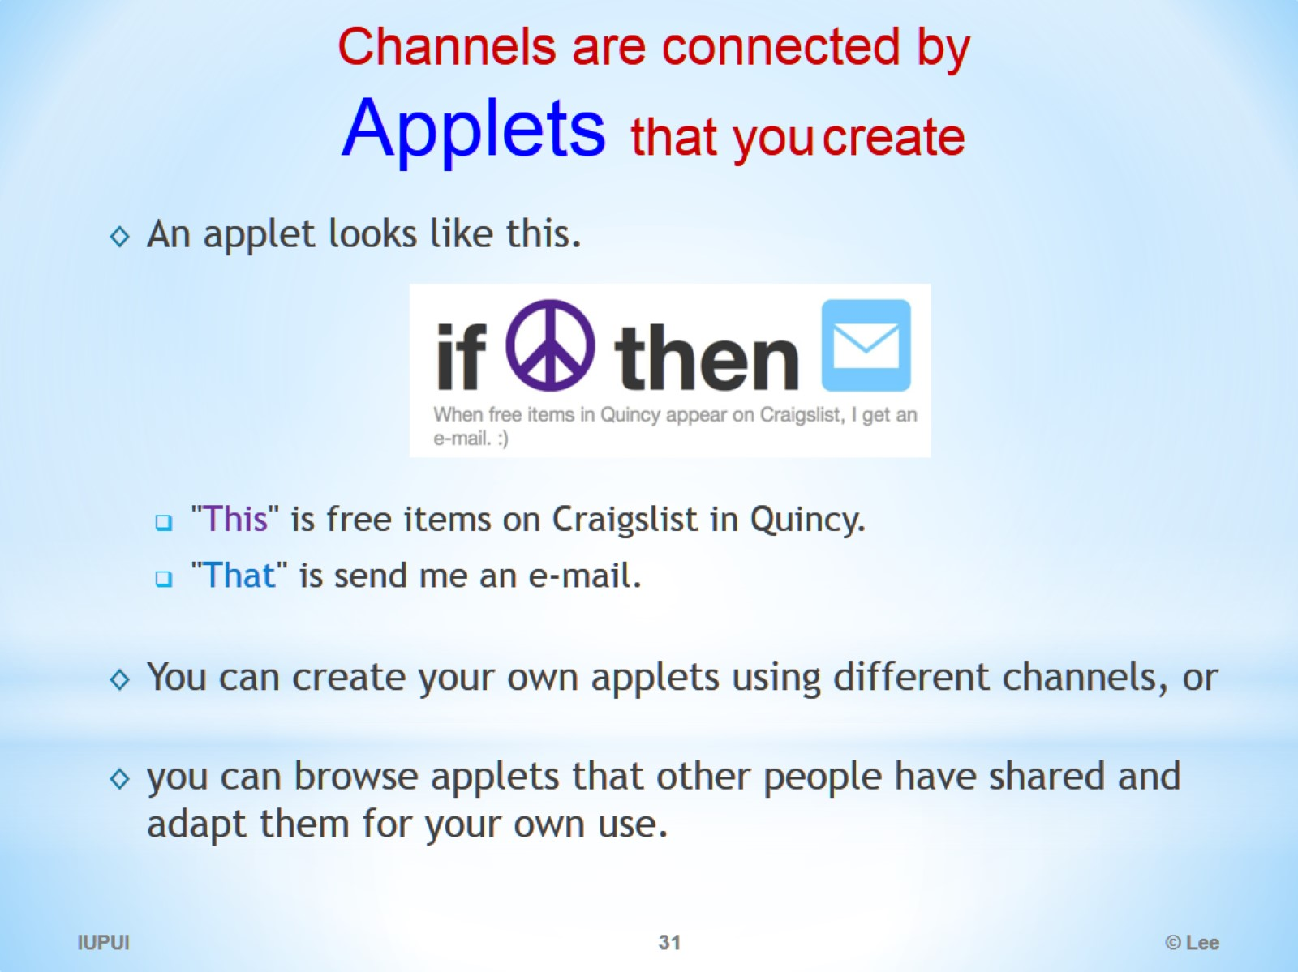
Channels are connected by Applets that you create

Slide 32
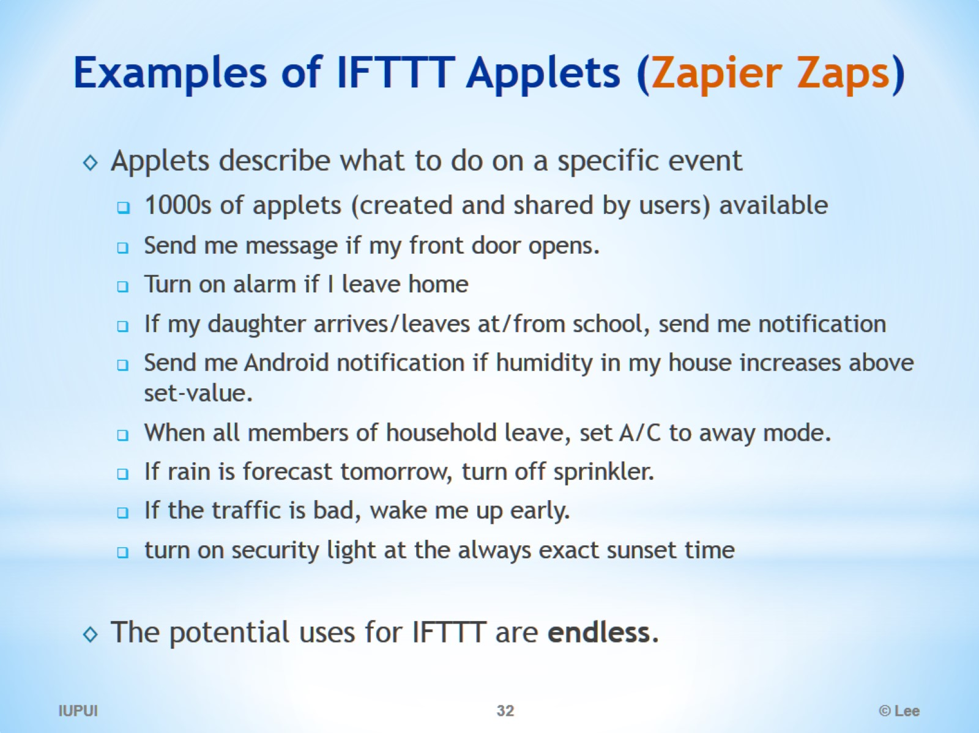
Examples of IFTTT Applets (Zapier Zaps)

Slide 33
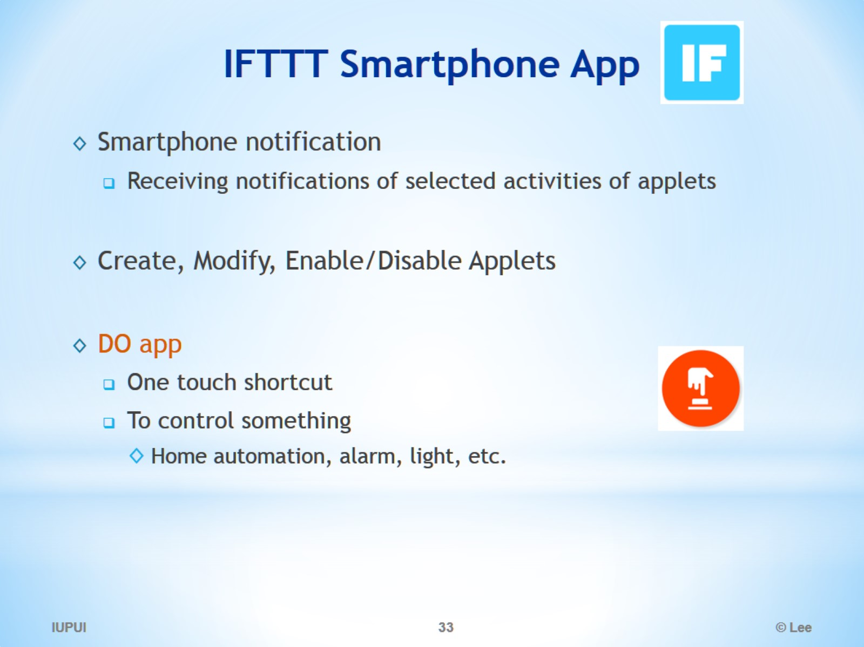
IFTTT Smartphone App

Slide 34
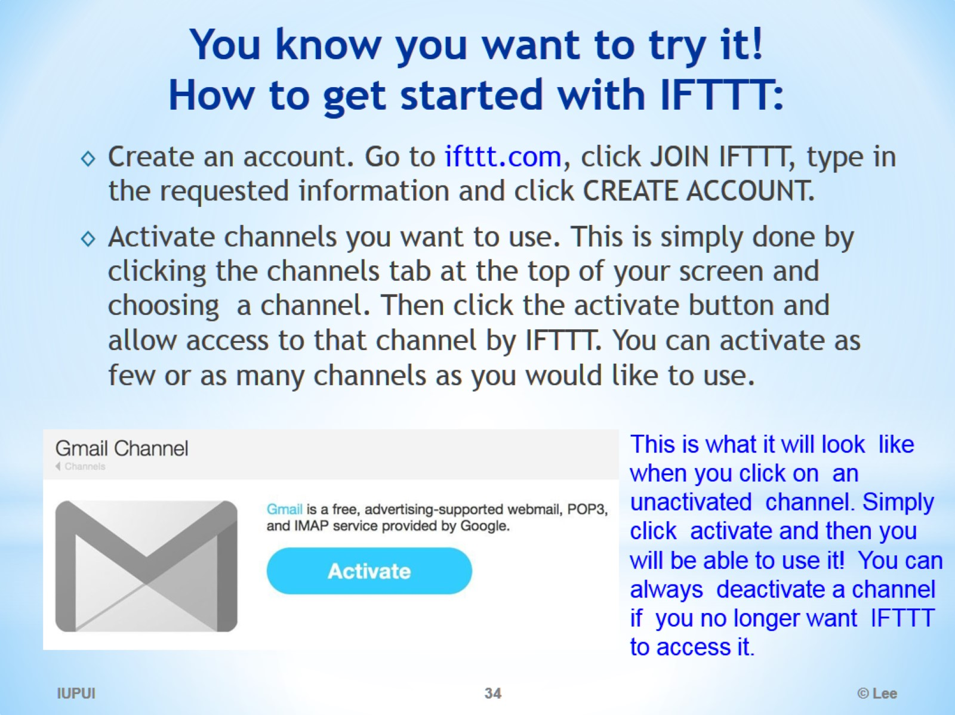
You know you want to try it! How to get started with IFTTT:

Slide 35
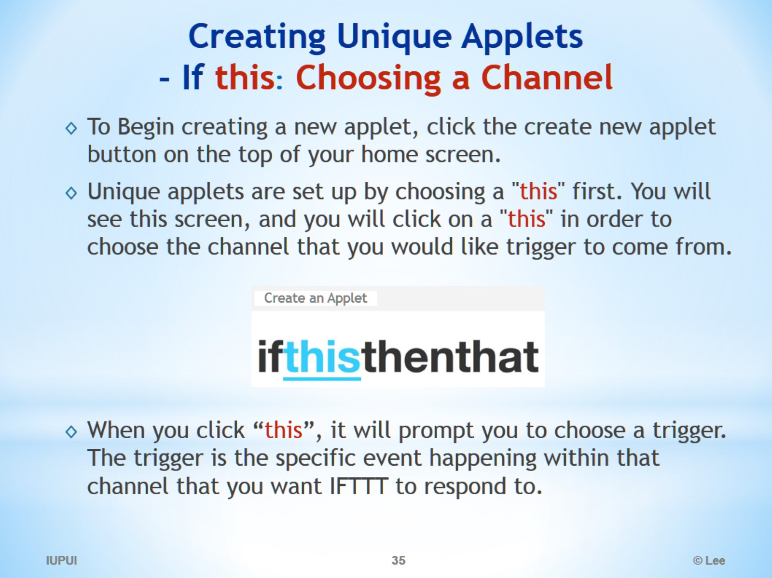
Creating Unique Applets - If this: Choosing a Channel

Slide 36
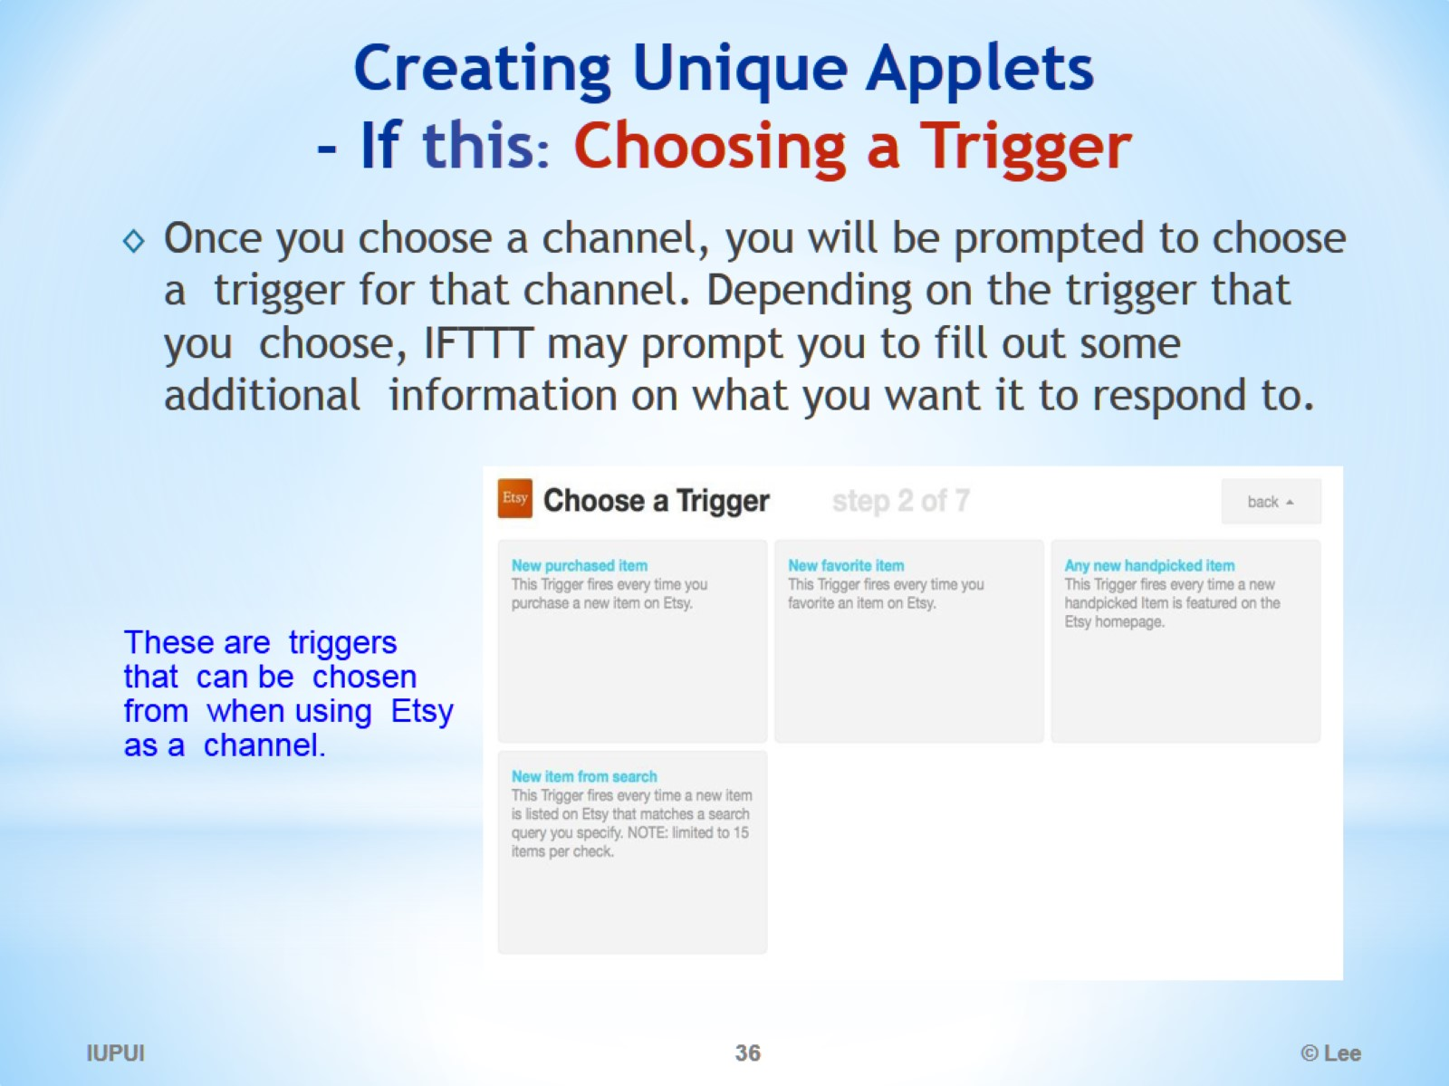
Creating Unique Applets - If this: Choosing a Trigger

Slide 37
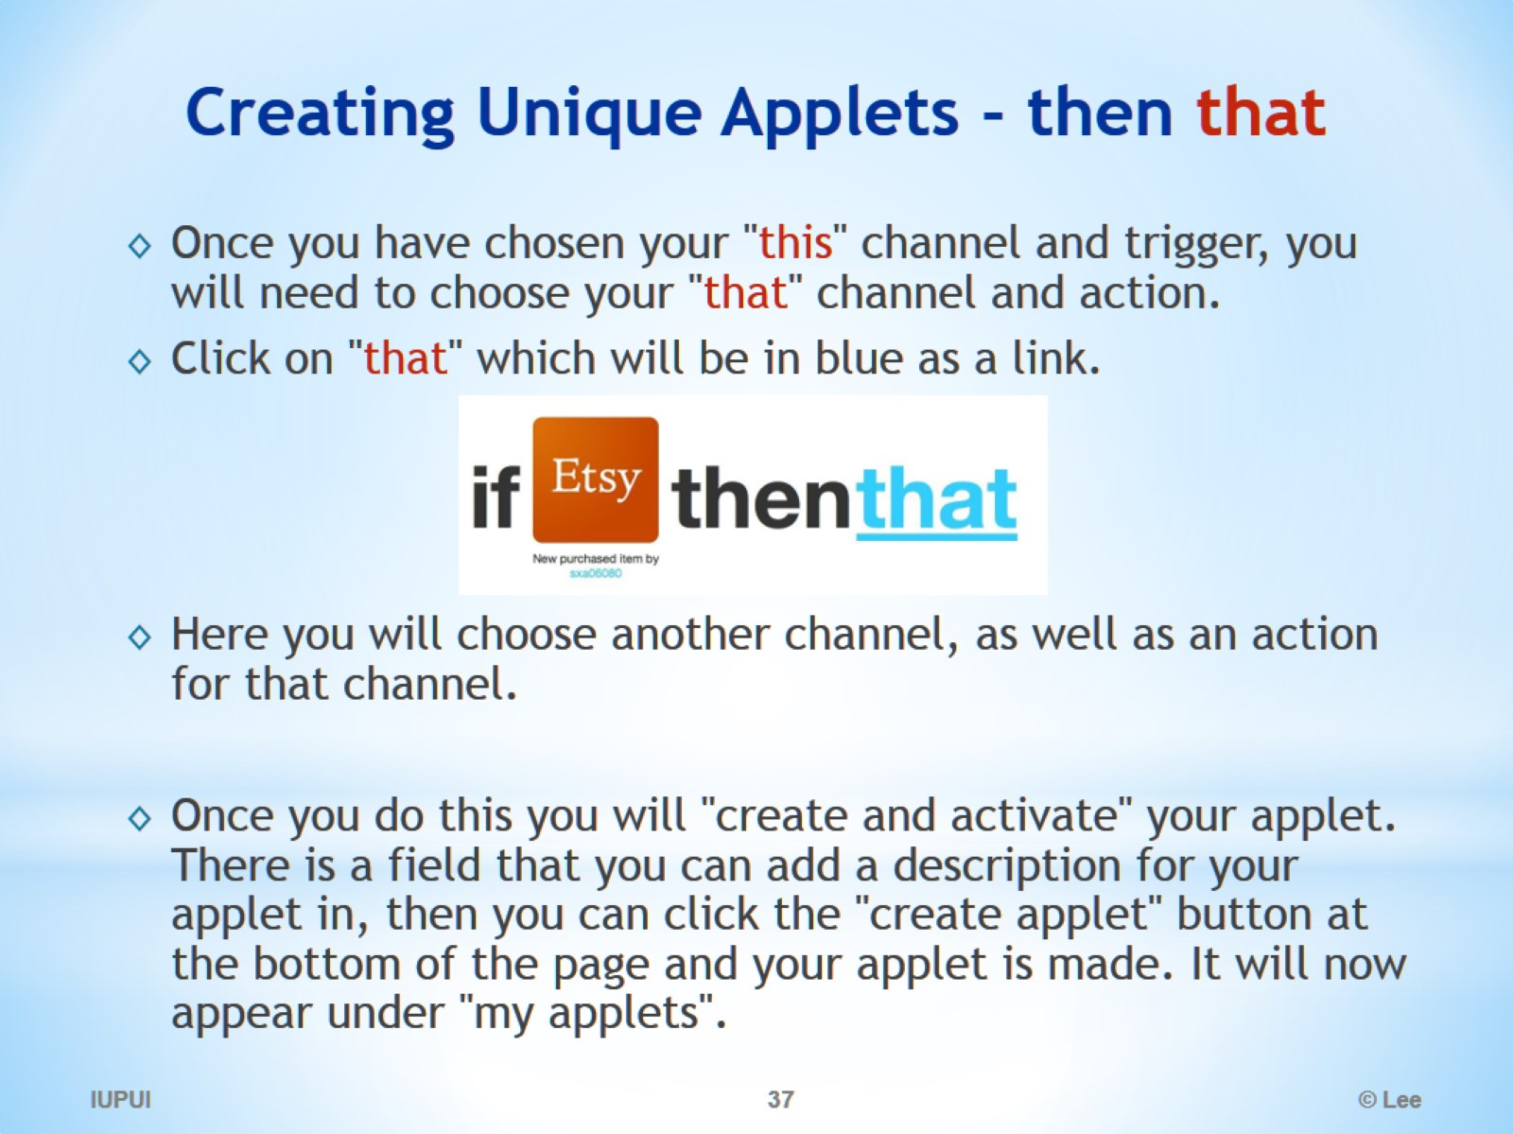
Creating Unique Applets - then that

Slide 38
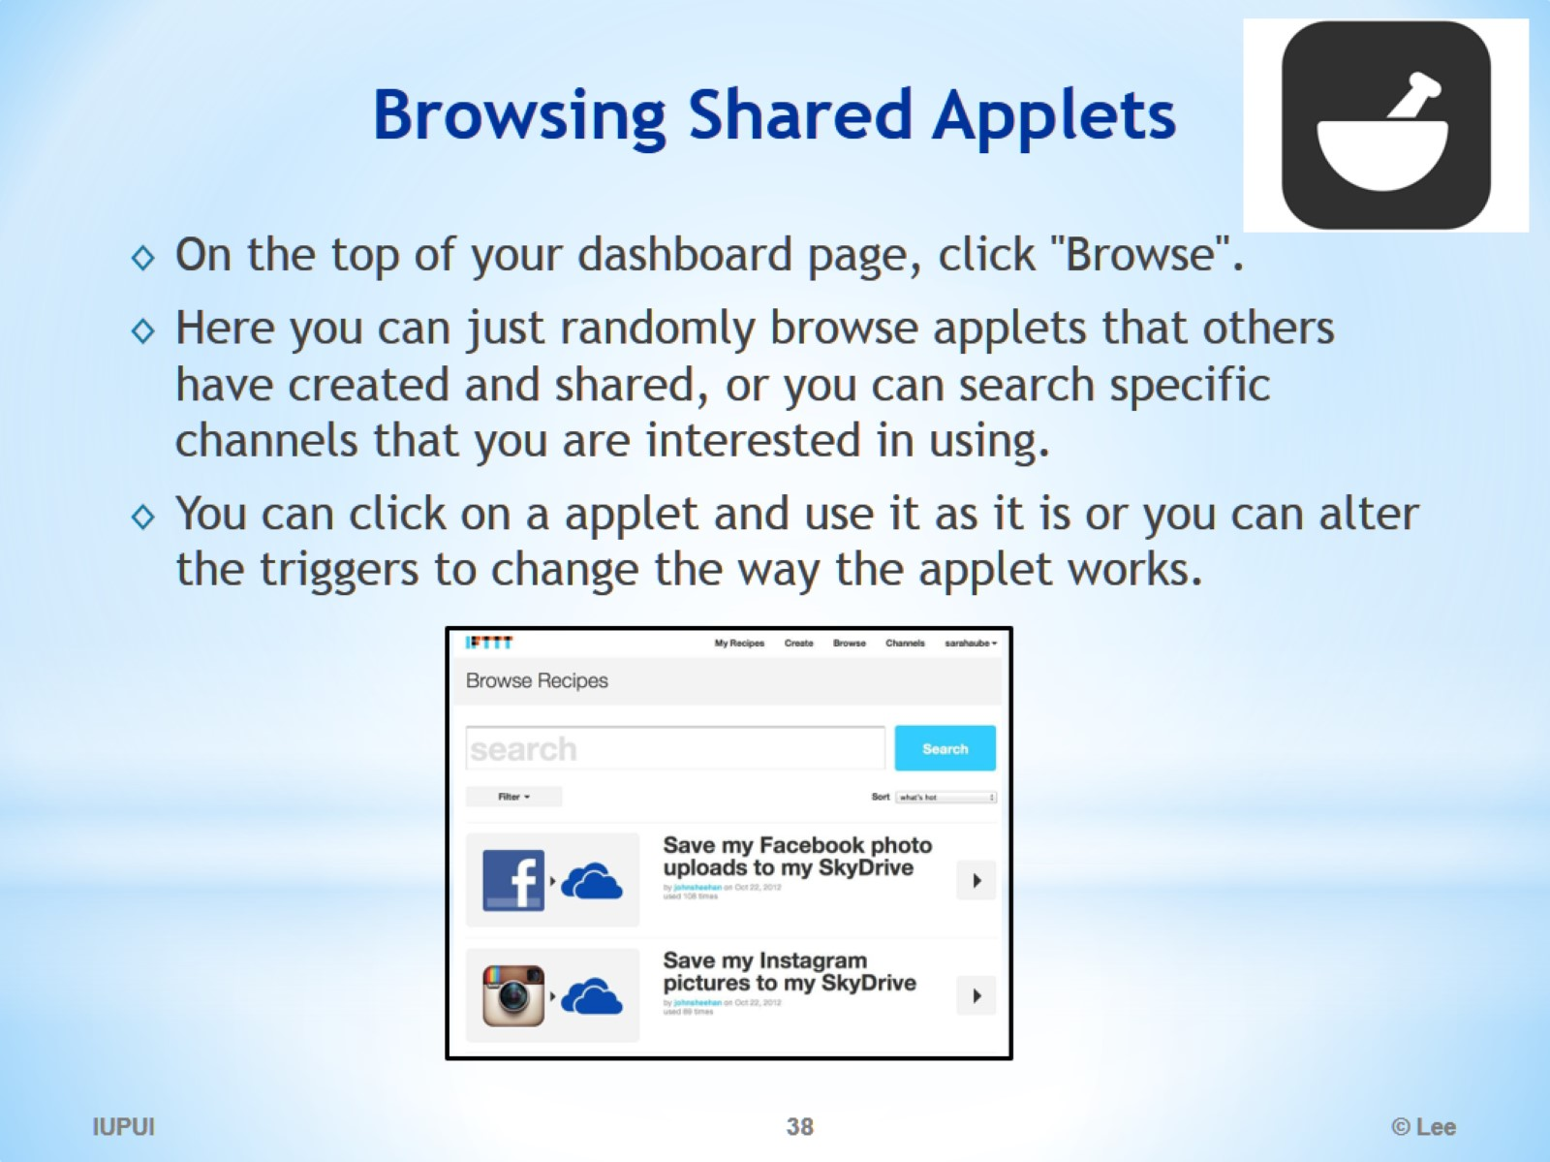
Browsing Shared Applets

Slide 39
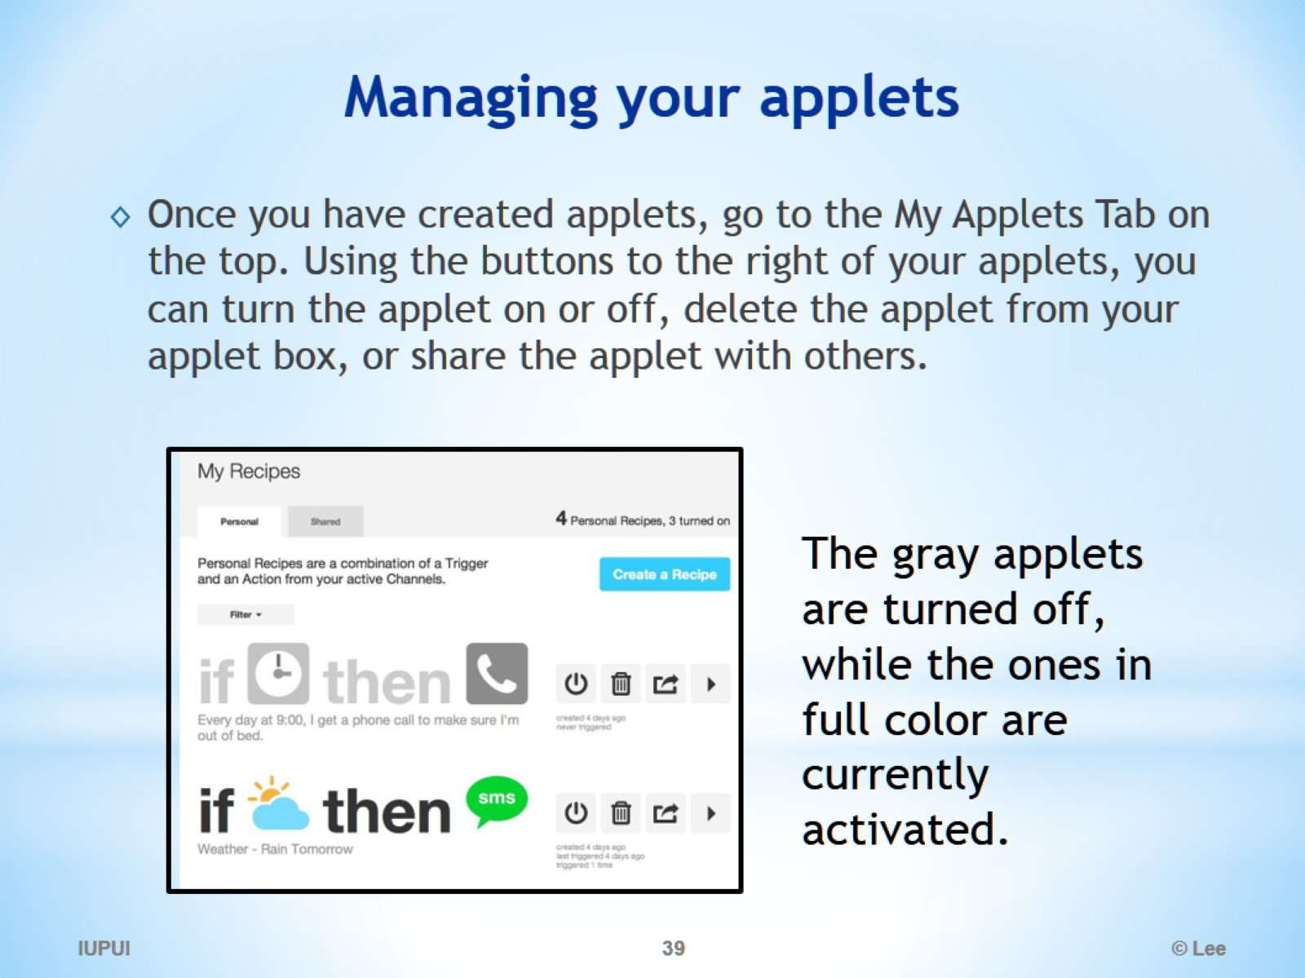
Managing your applets

Slide 40
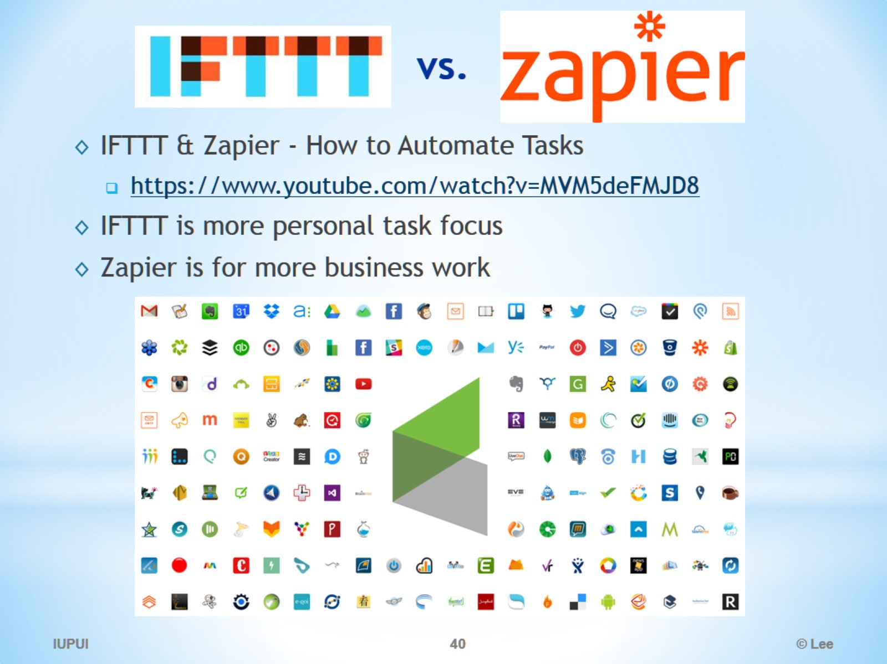
vs.

